Slide 1
Tools for Matt
Ali, DJ, John, Jen

Slide 2
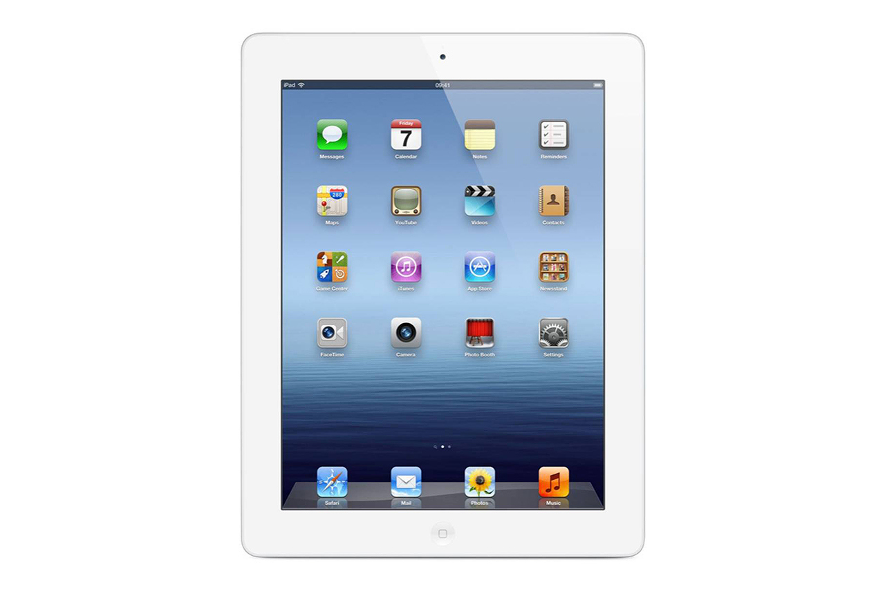
iPad/Smartboard
AIRSKETCH

Slide 3
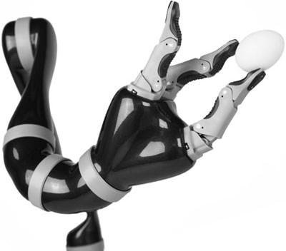
JACO
For everyday use and science experiments

Slide 4
EYE GAZE
When Matt can no longer talk or use his hands to help him, eye gaze can be beneficial. He can use this device by looking at what he wants to do with his eyes.

Slide 5
WORD DOMINO APP
This app was designed with a speech pathologist. It will help work on his vocabulary and reading skills.

Slide 6
Time Money and Fractions on Track App
This app has video features, parent sections, and children’s sections. It will help with learning time, money, and fractions, but in a fun way on his iPad

Slide 7
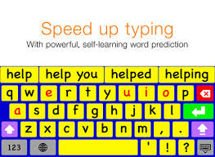
KEEBLE APP
This app allows students and adults with physical and vision impairments to type in any app

Slide 8
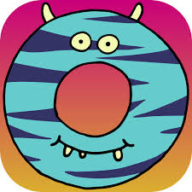
Little Digits App
Puts a new spin on finger counting that teaches children about numbers

Slide 9
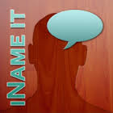
iNAME IT App
An app that assists children with word finding

Slide 10
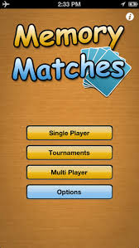
MEMORY MATCHES APP
A single, multi player game that stimulates the mind and requires minimal use of motor skills

Slide 11
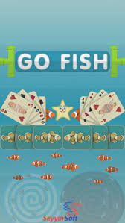
GO FISH APP
A digital card game that Matt could play with family members or even classmates

Slide 12
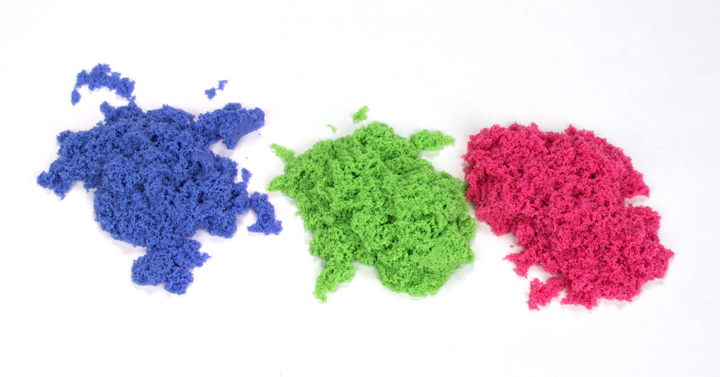
KINETIC SAND
Matt could use kinetic sand for many different areas. In art when his class is using clay or as a therapeutic technique.

