Slide 1
Technology For Case Study - Matt
October 2, 2015

Slide 2
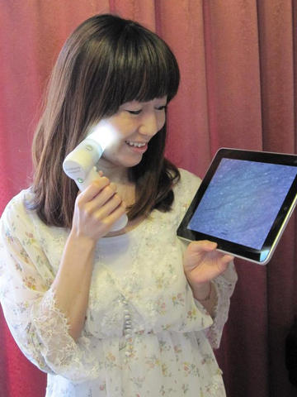
AirMicroPad
This is a wireless microscope. It can display and preserve a picture captured with “AirMicro” and “ProScope Mobil” as well

Slide 3
Teach Me – 1st Grade
This app can recognize handwriting relating to math: numbers, addition, and subtraction.

Slide 4
Math Ninja
It’s an action math game that is an app.

Slide 5
Endless Reader App
introduces "sight words", the most commonly used words in school, library, and children's books

Slide 6
Toontastic
Toontastic is a creative storytelling tool that empowers kids to draw, animate, narrate, and record their own cartoons

Slide 7
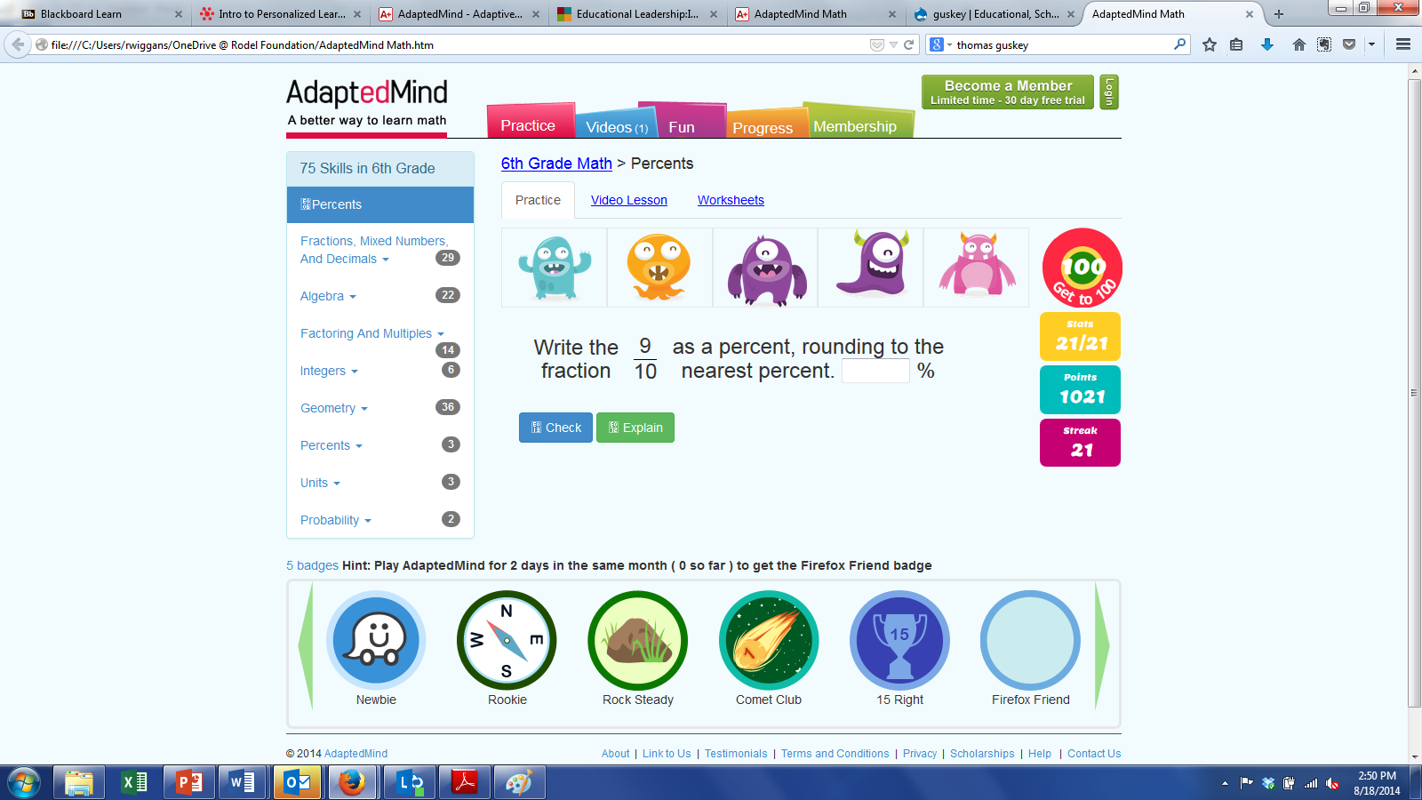
Adapted Mind Website
Offers different grade level math and reading skill games to play

Slide 8
Dragon Dictation
Allows you to use your voice to dictate a text message or email, create Facebook status updates, tweets, and anything in between.

Slide 9
Puffin
As Matt looses function of his hands and wrists, or as he becomes more fatigued throughout the day the puffin would be helpful with his use of the ipad for many aspects of school.

Slide 10
ITooch
With more than 25,000 exercises, iTooch Elementary is a new and fun way of practicing and learning Math, Language Arts and Science for 1st, 2nd, 3rd, 4th or 5th Graders

