Slide 1
Abilities Expo September 20th 2015
Ali Kennedy

Slide 2
Abilities Expo
The Abilities Expo is traveling around the United States, bringing the necessary products and services for people with disabilities. Families, caregivers, and healthcare professionals also can attend the Expo for helpful products and to gain more knowledge.
Notes:
I was super excited for the Abilities Expo! I did some research when signing up for the expo and was really interested in what it had to offer. All the different vendors and places the Expo traveled too is a really neat way for everyone to see and test the latest technology.

Slide 3
Abilities Expo Boston MA
The Abilities Expo came to Boston Massachusetts on September 18th-20th. It took place at the Boston Convention Center. There were many vendors there throughout the weekend as well as many demos and talks to be heard. It is a chance to see the latest technology and hear many compelling talks!
Notes:
On September 20th at 11:00 am I was able to attend the Abilities Expo at the Boston Convention Center. When entering the expo I was given a bag to collect different pamphlets and freebies from different vendors. I visited several different vendors and spoke with many different reps from different companies. It was very different then what I was expecting. I thought it would be more computer technology based because of the special education classrooms I have been in have all used technology in a computer based way. It was a very eye opening experience and I am now able to see technology in many different ways.

Slide 4
INvisible Project
“The Invisible project shows the day to day experiences of pain survivors through photos. The photos capture the struggles and hardships of pain survivors. The project allows the outside world to take a glimpse of what its like to live with pain while trying to living their lives. The goal is to create pain awareness, empower survivors and generate change.”
Notes:
This project is incredible. Pictures are very powerful and I think this project can go a long way. Each picture above shows us just a glimpse of their pain. All of the participants have put themselves out there for others to see their pain and that’s truly a heroic act. It will really create awareness the more it gets shared and put out there for others to see and hear about. A picture is really worth 1000 words.

Slide 5
Reach 4 Real
“Reach 4 Real delivers adaptive music programs and musical theatre classes designed for people with developmental, physical, and intellectual disabilities. The goal of this program is to enhance the life experience of people with needs through music enrichment.”
Notes:
This vendor I chatted with for quite a bit. I have seen music really go a long way for those with disabilities. Music and theater are both very uplifting and I really liked the motive behind this group. I watched a few vidoes and talked with the few representatives for the program and they were so happy and excited to talk about something they love to do.

Slide 6
Northeast Passage “Living Beyond Disability”
“The mission of Northeast Passage at University of New Hampshire is to create an environment where individuals with disabilities can enjoy recreation with the same freedom of choice, quality of life, and independence as their non disabled peers. We do this by developing and delivering barrier free recreation and health promotion programs.”
Notes:
This is so cool to me! I talked with the rep and he was a college student from UNH he had so much to say about the program and all that they do there. Its neat to see a program like this that is paired with a program like this. I thought it was really interesting and an awesome way for people with disabilities to be able to play sports and be active in the community. They had a really cool adaptive ski seat at the expo that allowed someone in a wheelchair to ski on the slopes!

Slide 7
Cambridge Commission for Persons with Disabilities (CCPD)
“CCPD promotes and advocates for equal opportunity for the full inclusion of persons with disabilities in all aspects of Cambridge life. They advocate for improved housing, transportation, and education. They also teach disability awareness to the community.”
Notes:
This is amazing and really something I am interested in doing more research on. I am all for any organization who will advocate for inclusion! This is a great organization for Cambridge to have and a great way for people with IDD to get the housing, transportation, and education that they deserve.

Slide 8
The Massachusetts Office on Disability
“The Massachusetts Office on Disability was created in 1981. The primary mission of MOD is to ensure the full and equal participation of all people with disabilities in all aspects of life by working to advance legal rights, maximum opportunities, supportive services, accommodations and accessibility in a manner that fosters dignity and self determination.”
Notes:
Again just like in Cambridge I am so happy that there are people out there with my passion for advocacy for those with IDD. Speaking up and fighting for rights is beyond important and it saddens me a bit that a group like this didn’t come together until 1981 buts its still amazing progress. This is another interest of mine that I would like to take a look at.

Slide 9
The Coalition Against Pediatric Pain “because no child should live in pain.”
“The Coalition Against Pediatric Pain is a national non profit committed to improving the quality of life of children living with chronic pain from rare diseases by: supporting and uniting families affected by pediatric pain, advocating for children in pain by increasing awareness of their needs, education others regarding their long term consequences of pediatric pain, funding research dedicated to pediatric pain conditions and providing resources to families and professionals.”
Notes:
I am a big fan of nonprofits I have a lot of respect for those who start them and keep them going. They truly do a lot of good in our world especially when children are involved. This is another group spreading awareness about children who deal with pain on a daily basis. They provide the children and their families comfort in the process they are going through. This is very unique and a great support group for those in need of help during this time.

Slide 10
U.S. Pain Foundation
“The mission of U.S. Pain Foundation is to connect, inform, educate and empower those living with pain while advocating on behalf of the entire pain community.”
Notes:
This is another pain advocacy group for those suffering with chronic pain. The foundation is set up to connect, inform, education and empower those living with pain. I found this interesting and its also based in CT which is where I am from and I have never heard of it before. It is a really good way to get the voices heard on something you wouldn't’t typically think about.

Slide 11
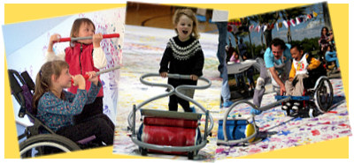
Zot Artz “Arts For All”
“Children love making art! Zot Artz is designed to make adaptive art tools so children with disabilities can create art. Zot Artz tools and facilitated art events teach and entertain children. Children of all abilities and ages can stamp, draw, and print to make their mark.”
Notes:
This was one of my favorite booths! We actually got to paint and see how the adaptive tools work it was really neat. I am excited that they are coming to Wheelock to do a demonstration it will be really interesting! Art is so theraputic and this booth showed how awesome their adaptive tools were for making art. I hope to be able to learn from this vendor and use art in my future classroom some day in this way with these tools.

Slide 12
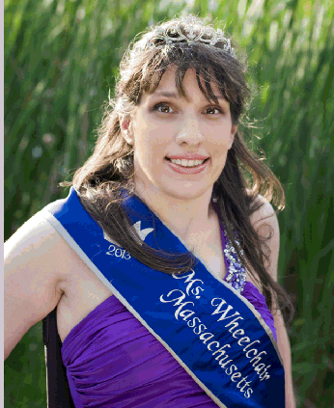
Ms. Wheelchair Massachusetts Foundation
“This pageant is a competition based on personal interviews, platform speech presentations and on stage interviews to find a state and national spokeswomen for the disabled. The mission of the Ms. Wheelchair America Program and the state programs is to provide an opportunity for women of achievement who utilize wheelchairs to successfully educate and advocate for individuals with disabilities.”
Notes:
Ms. Wheelchair is truly amazing it’s a great way to teach young women to advocate on their behalf as well as others. It’s a very meaningful form of a beauty pageant that takes on a very inspiring role in womens lives. I would really like to reach out to this foundation and see if they would speak at a best buddies event here on campus.

Slide 13
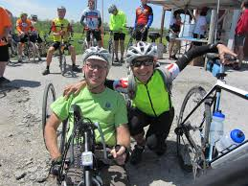
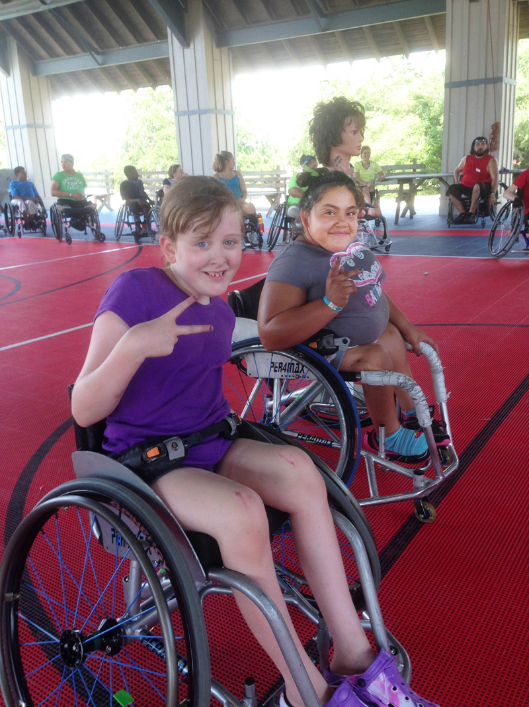
Empower Spinal Cord Injury
“Empower SCI is a nonprofit corporation established to enable individuals with spinal cord injuries to lead happier, more meaningful and independent lives. Empower SCI seeks to fill the gap in the rehabilitation industry that has been created by a decrease in length at rehabilitation hospitals and outpatient services during the recovery from a spinal cord injury.”
Notes:
This is something really close and special to me. My Grampy suffered a spinal cord injury 12 years ago. He is now paralyzed from the waist down and his whole life changed. My whole families lives changed. Again this is a nonprofit who is helping those who suffered a spinal cord injury live a better life. I wish my family had looked into something like this for my grandfather and maybe we as a family could have been given support as well.

Slide 14
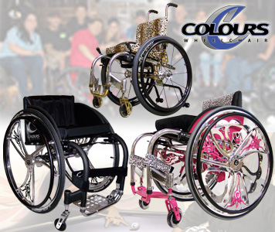
Colours Wheelchair
“Colours Wheelchairs has been committed to bringing equipment and services to the disabled to help improve their lives since 1992. Colours ‘N Motion designs and manufactures very specialized rigid everyday and rigid sport wheelchairs for an international market of disabled customers. John Box is the founder who was paralyzed in a motorcycle accident in 1981.”
Notes:
This was the first vendor I visited at the expo and it was really cool. We sat in a few different chairs and got to wheel around and really feel the shock impact in the chair. Its unlike any wheelchair I have seen. It was really cool to look further into this company and see that they were started by a man who was paralyzed from a accident and wanted a better chair. Many different wheelchair companies were at the expo and I found Colours to be my favorite.

Slide 15
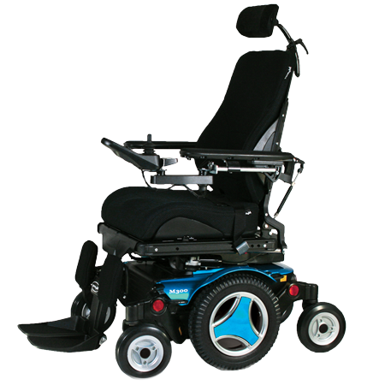
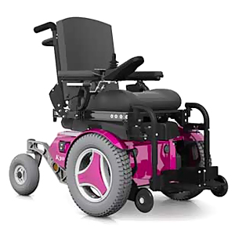
Permobil “The Power Of Mobility”
“The mission of Permobil is to develop, manufacture and market wheelchairs and transport- and communication systems for people with functional disabilities. Their products will lead quality, performance, safety and how function are concerned in order to provide users with the best possible compensation for their disabilities.”
Notes:
This is another wheelchair company I was impressed with. There are so many different versions of wheelchairs in todays market and Permobil is very interesting. They had a very high tech way of manufacturing these wheelchairs and I was impressed with all the thought put into them.

Slide 16
The Department of System-Wide Accessibility
“Established in 2007, the Department of System-Wide Accessibility works with all other MBTA departments to execute the T’s mission of becoming the global benchmark for accessible public transportation.”
Notes:
Finally public trasporation began to be accessible to those in need. This department works with the MBTA to make the T more accessible for those with disabilities and this is very important here in the city. Those with IDD need to be able to get around using public tran just like anyone else and now they have a department fighting for these rights.

Slide 17
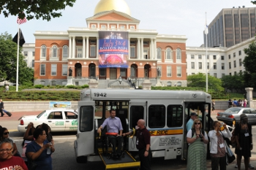
THE RIDE Paratransit Program
“The Ride paratransit service provides door-to door, shared-ride transportation to eligible people who cannot use fixed-route transit (bus, subway, trolley) all or some of the time because of a physical, cognitive or mental disability.
The Ride is operated by the Massachusetts Bay Transportation Authority (MBTA) in compliance with the federal Americans with Disabilities Act (ADA).”
Notes:
The ride is truly amazing. Some of my best buddies clients use it to get around the city and it is truly great. The MBTA has come a long way and this is one of its perks. Someone with IDD can call for a ride and be picked up and taken where they need to go. Its almost like a taxi but it can support wheelchairs and its more accessible then the bus or T.

Slide 18
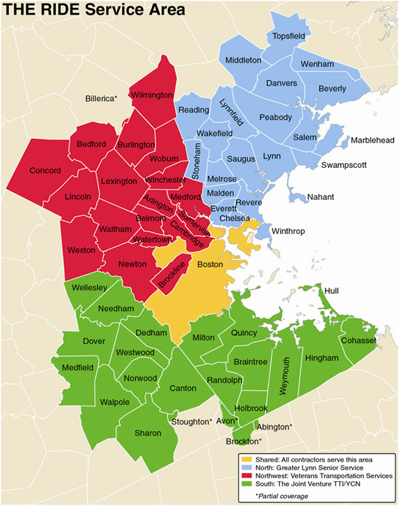
Access Advisory Committee to the MBTA
“The Access Advisory Committee to the MBTA is a consumer organization with the mission of improving transit access and services for people with disabilities. Its membership is open to people with disabilities and senior citizens. The members work closely with the MBTA departments and the office for transportation to improve safety, efficiency, and accessibility of the MBTA system.”
Notes:
This Advisory committee I am really impressed with. Their mission to improve tranist access for those with diabsilites is something we have needed for a long time. So many have fought for this but it took a long time but it is worth it.

Slide 19
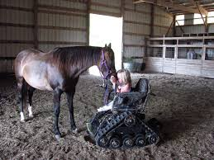
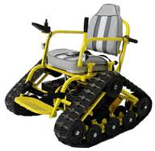
Action Trackchair “Helping The Disabled To Be Enabled”
“The Action Trackchair and Trackstander come equipped with power seat tilt as a standard feature making it the ultimate in off-road wheelchairs. You will go places you didn’t think possible. With the Action Trackchair you will be able to navigate mountain roads, campgrounds, woods, beaches, hiking trails, frozen lakes, shallow streams, muddy and snowy terrain and much more. Now you have the choice to stay on hard surfaces or go off-road.”
Notes:
This is another wheelchair that was really impressible. How cool is it to be able to go off roading in a wheelchair that can actually do so! Trackchair is a wheelchair designed to do things I have never seen a wheelchair be able to do. This technology is truly amazing.

Slide 20
The Garage Handicap Lift Repair
“The Garage is a locally owned and operated automotive service center founded in 2009. We strive to deliver quality products to our customers. The Garage’s mission is to provide quality and dependability to fleet and handicap van owners on the North Shore of Massachusetts. We take pride in offering efficient, effective, and friendly service to vehicles of all types. However, our specialization in wheelchair lift repair, handicap van maintenance, and fleet maintenance is what sets us apart from the competition.”
Notes:
I felt this vendor was important because a handicap van will always need to be fixed just like any car and this is a place that provides it. Im impressed that someone thought of this and was able to put this together. I now have a place that I no does this if I ever am driving a van and need help or if something is wrong.

Slide 21
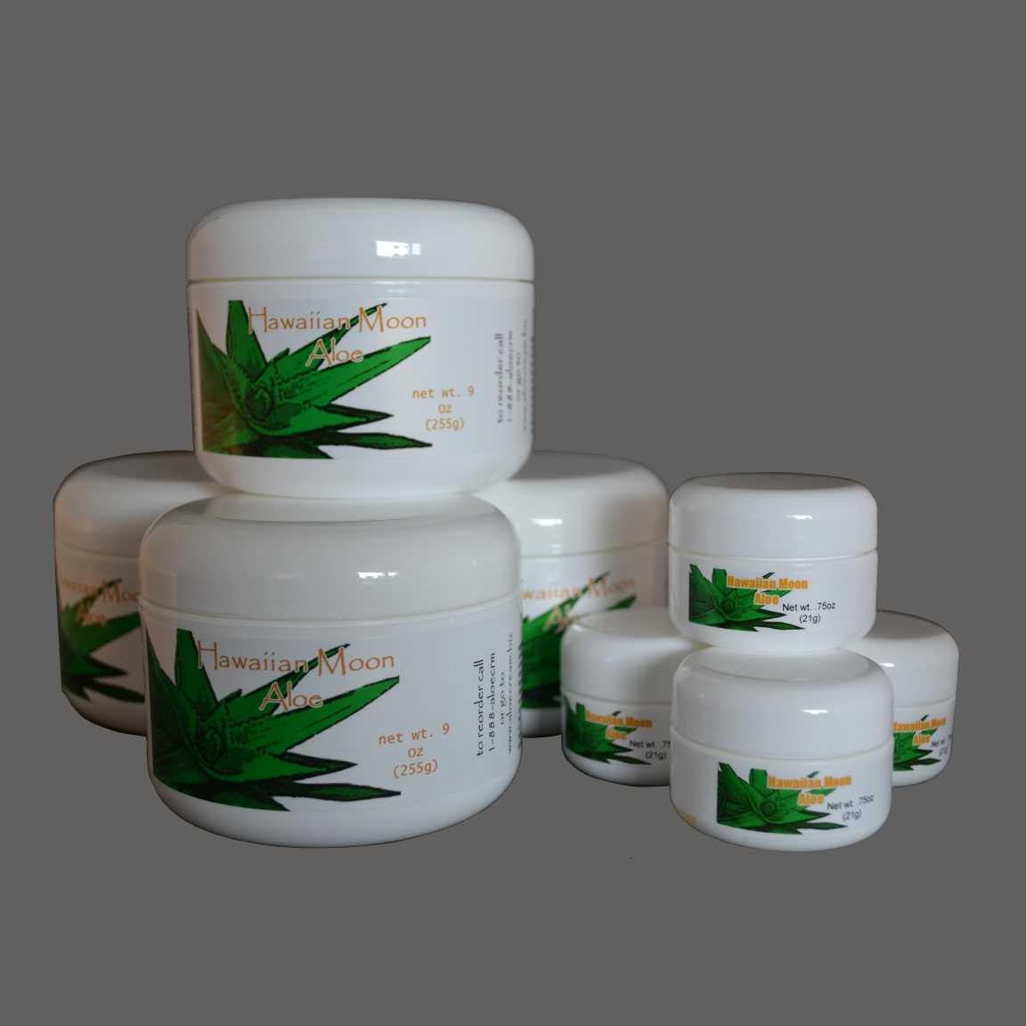
Aloe Cream “Featuring Hawaiian Moon Aloe Vera Skin Cream”
“Hawaiian Moon Aloe Vera skin cream is solely distributed by Hawaiian Moon Inc, a family owned and operated company. Hawaiian Moon Aloe skin cream uses 100% organic Berbandesis aloe, one of the highest grades of aloe around. The cream is 98.5% natural and over 72% organic.”
Notes:
This vendor seemed to be a bit out of place at the expo. But I tried it and the sales rep explained all the benefits and so many people would benefit from it but its super expensive. Once the cream was on you could actually feel the difference. I was really impressed with how it worked but felt it was rather over priced for a cream.

Slide 22
Resources
http://www.abilities.com/expos/
http://www.aloecream.biz/
www.theonlygarage.comhttp://www.aloecream.biz/
www.actiontrackchair.com/Default.aspx#.Vg4FpHt1Bl8
http://www.mbta.com/riding_the_t/accessible_services/?id=26302
http://www.permobil.com/en/Corporate/
http://colourswheelchair.com/
http://www.empowersci.org/about-us.html
http://mswheelchairmass.org/
http://www.zotartz.com/
http://www.invisibleproject.org/www/
http://offers.therealschoolofmusic.com/reach4real
http://nepassage.org/
https://www.cambridgema.gov/DHSP
http://www.mass.gov/anf/employment-equal-access-disability/oversight-agencies/mod/
http://www.tcapp.org/
http://www.uspainfoundation.org/

