Slide 1
Assistive Technology for Matthew

Slide 2
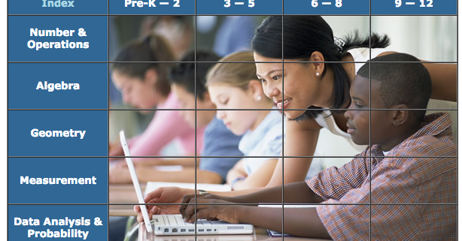
National Library of virtual MANIPULATIVE

Slide 3
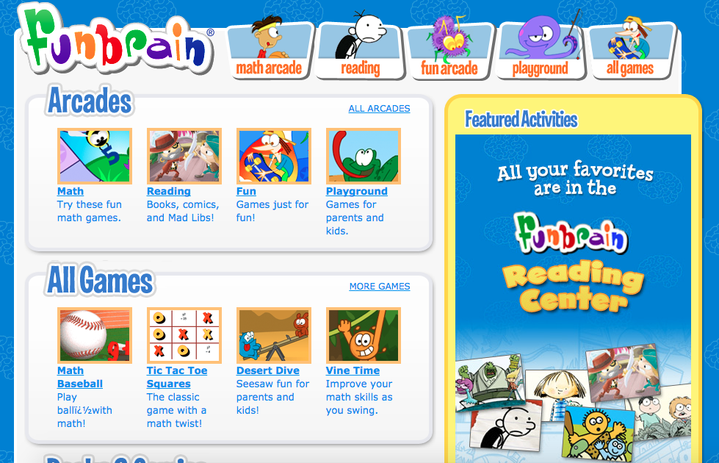
fUNBRAIN.COM

Slide 4
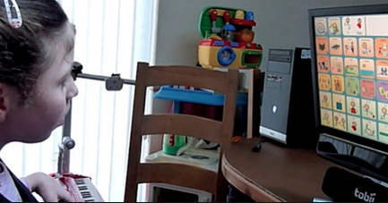
EYEGAZE

Slide 5
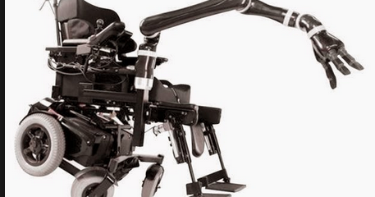
JAco

Slide 6

Abcya.com

Slide 7
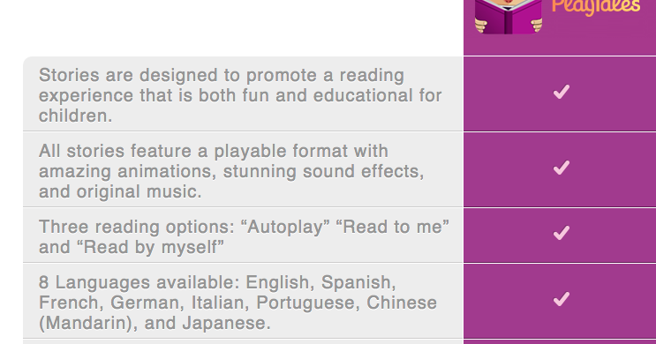
TouchybOOKS

Slide 8
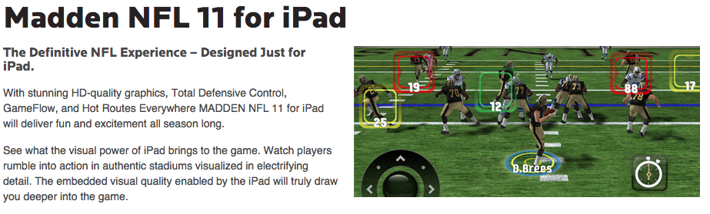
Madden nfl 11

Slide 9

Sports illustrated: KIDS!

Slide 10

Kids learn football

