Slide 1
Idea to App

Slide 4
Is app development something your passionate about?
Why are you interested in app development?
What do you know about app development?
What do you plan to learn today?

Slide 5
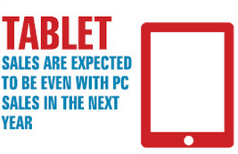
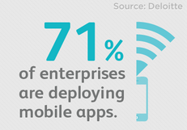
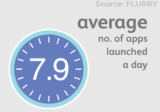
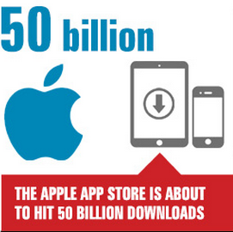
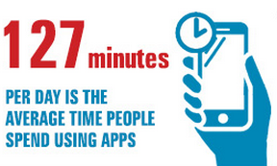
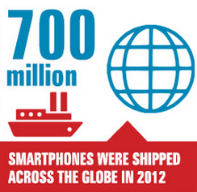
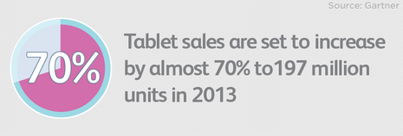
Fun Facts

Slide 6
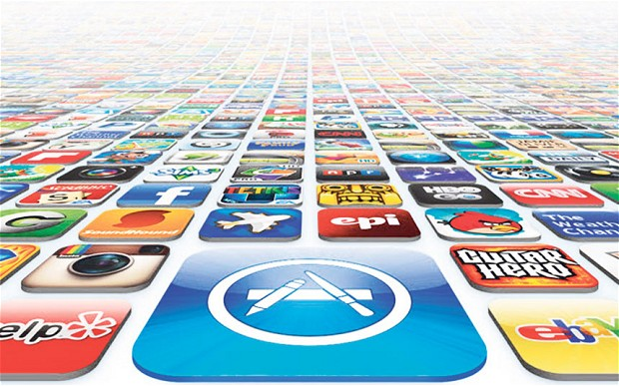
Why Apps
Accessible
Familiar
Popularity
iPad’s multi-purpose use
Internet access

Slide 8
Comparing App Types
 | Web App | Native App
Internet Access | Required (in most cases) | Not required
Installation/Updates | Hit refresh | Must be deployed or downloaded
User Interface | Browser can be clunky | Responsive and functional
Device Compatibility | Platform-agnostic (can be reformatted to suit any device) | Platform-dependent, hardware-dependent
Development Costs | Reasonable | Higher
App availability | Approval required – app directly accessible to anyone once launched | Approval (by Apple App Store, etc.) necessary for app publication
Access to hardware sensors | Access through browser is limited | Yes e.g. Camera, microphone, compass, GPS

Slide 9
Comparing Native Platforms
 | Android | iOS
Compatibility | High - Kindle Fire, LG, HTC, Samsung, Sony, Motorola, Nexus & others (costly) | Low - iPod Touch, iPhone, iPad (Affordable)
Customer Revenue Opportunity | 20% | 80%
Business Revenue Opportunity | 25% | 75%
App Policies | Less restrictive | Strict
App Quality | Lower | Higher
Coding Language | Java | Objective C

Slide 10
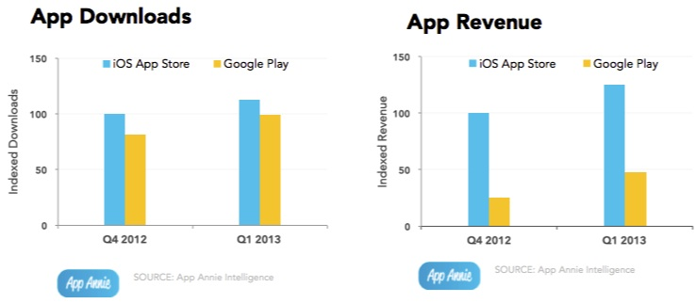
iOS VS Android

Slide 11
Take a moment to think about an app and do you believe it is successful?

Slide 13
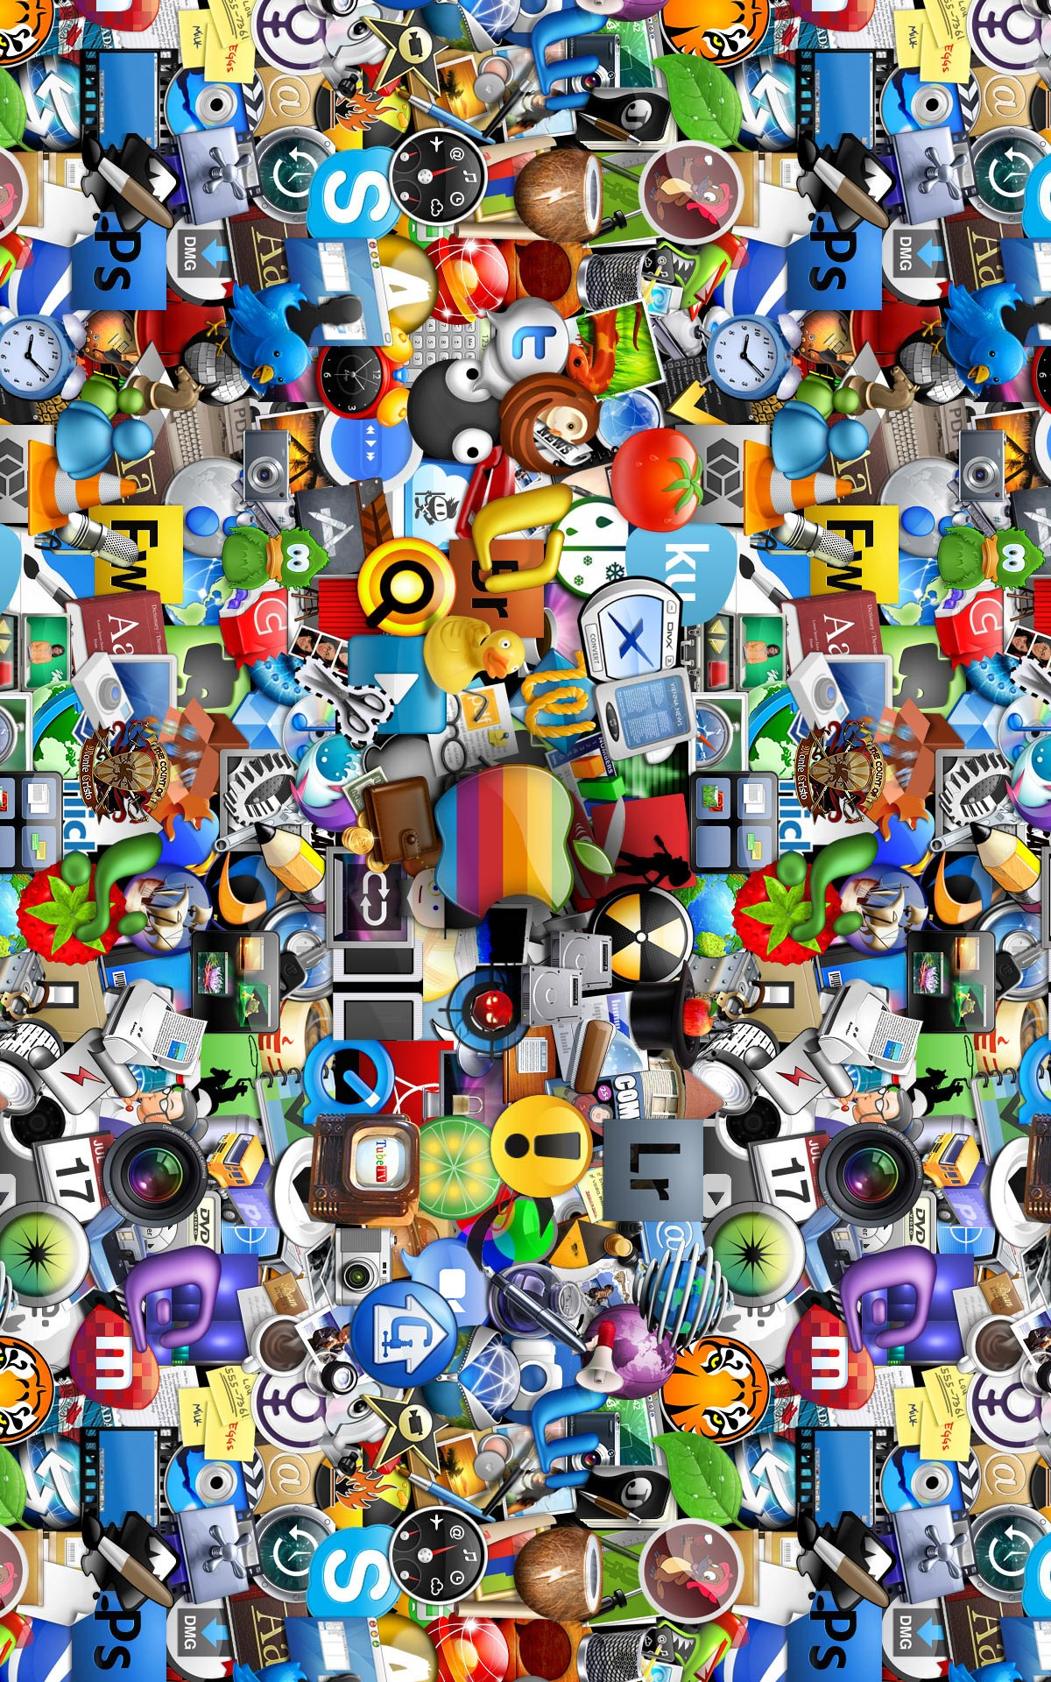
What makes a good app?
Intuitive
Original
Publishing features
Design & user experience
Photos
Fun
Voices
Support
Accessibility
Customisation
Saving & reporting

Slide 14
Idea Generation
Follow the market
What is most successful and why?
Pick project you:
Are passionate about
Understand
Can bring a unique perspective or intelligence to

Slide 15
Remember that your app concept doesn’t have to be completely polished or finished when you start developing your app

Slide 16
The App Development Process
Understand the scope
Creating user experience
Development stage
Map out a timetable
Testing the app
Submission to app store

Slide 17
Putting Together a Business Case
Think about:
Audience
Platform
Devices (smartphone, tablets)
Key features
Research competitors
Do you want to make money from the app?
Will you make a profit?

Slide 18
Assessing Feasibility
Technical feasibility
App/product feasibility
Market feasibility
Legal feasibility

Slide 19
1. Technical Feasibility
Answer the question “can it actually be
built?”
Can feature work
Is relevant technology mature enough?
If no, alternatives to each technology
Will it be suitable for the app
Will it give the user the outcome
they want
How long does it take to implement this
feature

Slide 20
2.App/Product Feasibility
Benefits of the app
Determining the app is:
A new concept
An old concept
Determine if the app has:
High competition
Low competition

Slide 21
3.Marketing Feasibility
Appeal to the market
Market timelines (best suitable time for release)
Competing apps (if any)
What is your differentiator
Are there new features in your app?

Slide 22
4.Legal Feasibility
Copyrights
Licensing agreements
Trademarks
Contracts

Slide 23
Intellectual Property
You can’t simply copy – need to be innovative!
Who owns the rights?
Case study – PRC Speak for Yourself

Slide 24
Legal Considerations
Who owns the app?
Individual
Organisation
Who owns the source code?
Terms and conditions
Non disclosure Agreement
Non-complete Clause
Symbol licensing cost

Slide 25
Putting Together a Scoping Document
There are certain essentials required:
Project background
Key requirements of the app
Where the app fits in
Top line flow of the app
Hardware/Devices
IPR
Timelines
Risks and mitigations
Project cost

Slide 26
Fill out the Scoping Document and you’ve jumped over the first hurdle!

Slide 27
Finding an App Developer
Compose a specification document that describes what your app does and for whom. Include sketches. This is what will enable the developer to put together the time and cost estimate.
It will also ensure that you hire developer who has the skills necessary to produce the app.

Slide 28
Working With App Developers
Sign an NDA
Help with scoping the idea
Explain the project process from start to end
Feedback on design and user interface
Updates on progress during development
Providing a beta version for external review
Testing and feedback
Support with app submission
Ongoing support after release
BRING THEM INTO THE DISCUSSION
EARLY!

Slide 29
Financial Considerations
Funding
Organisation
Government
Individual
Return of investment
Will this app be a free app?

Slide 30
Development Costs
Developer costs
Additional API
Designer
Submission of the app
Infrastructure: Unless your app does not require any interaction with external servers, keep in mind that server development and infrastructure is critical for the app to succeed.

Slide 31
Ongoing Costs
If the cost of the app was 10 AUD

Slide 32
Remember to keep some money on the side in case you want to create further updates or market your app!

Slide 33
Working With Us Is Simple
Non Disclosure Agreement
Idea Building
Business Goals
Development
Completion!
You will also receive ongoing support

Slide 34
Know what is out there
Agree on goals for the app
Understand the target users
Consider what platform
Consider feasibility - Include your app developers early!
Put together a well thought through and in depth scoping document
Key messages to take home

