Slide 1
My Expo Experience
Toni-Ann Capillo

Slide 2
Disability reframed film screenings
Disability reframed is a free community film series that is held every 6-8 weeks. The film series explores the portrayal of disability through/in film.
Next film that will premiere is La Casa Linda
“When your road comes to a dead end, keep on going”
A movie that will premier on Saturday November 7, 2015
Locally at the Cambridge Public Library
This film is a documentary about disabilities and independence
click here for more infromation
Notes:
I found this to be very interesting that the cities of Boston and Cambridge present a community film series that allows its community to explore culture, celebrate disability culture, share a love of cinema, socialize and share experiences and new discoveries, and challenge the way that people with disabilities are portrayed in pop. culture.

Slide 3
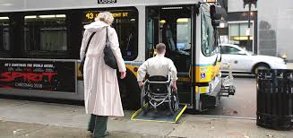
MBTA Access guide
The MBTA access guide is an interactive manual for customers with disabilities. The access guide includes
General accessibility facts that are in effect system wide
How to plan a trip on the MBTA fixed route system
The customers experience and acceptability features
Information on how to use farebox and fare vending machines
clcik here for more information
Notes:
I think that MBTA access guide online is very useful to people traveling with disabilities. People with disabilities have to plan when taking the T. Because not all locations are accessible to people with certain disabilities. This online tool is useful for people who live in and or our visiting the Boston area.

Slide 4
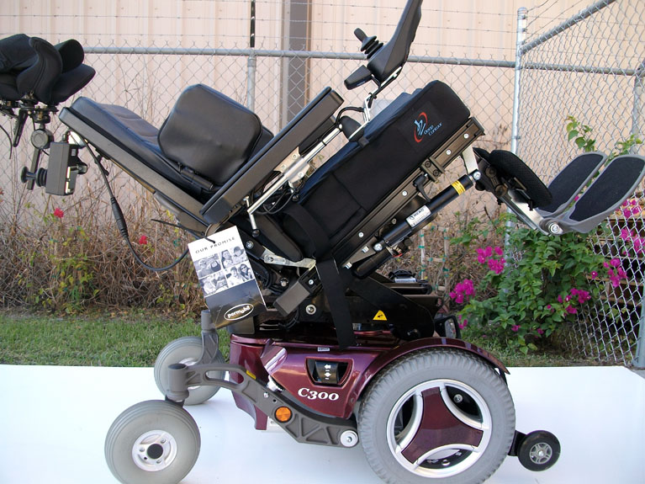
Permobil
“Stand for function, stand for health, stand without compromise”
Permobil is a wheelchair company that offers a Varity of wheelchairs. They create custom wheelchairs, pediatric wheelchairs, indoor/outdoor wheelchairs, and corpus seating wheelchairs.
Click here for more informaiton
Notes:
These wheelchairs come with many different functions allowing children and adults to partake in everyday actives. These wheelchairs can be customized to fit each and very person to their exact desires and needs. They even offer a standing wheelchair. Before the expo center I was not aware that they offered standing wheelchairs. It was amazing to see how far assistive technology has come. The company started off small in a mans basement in Sweden.

Slide 5
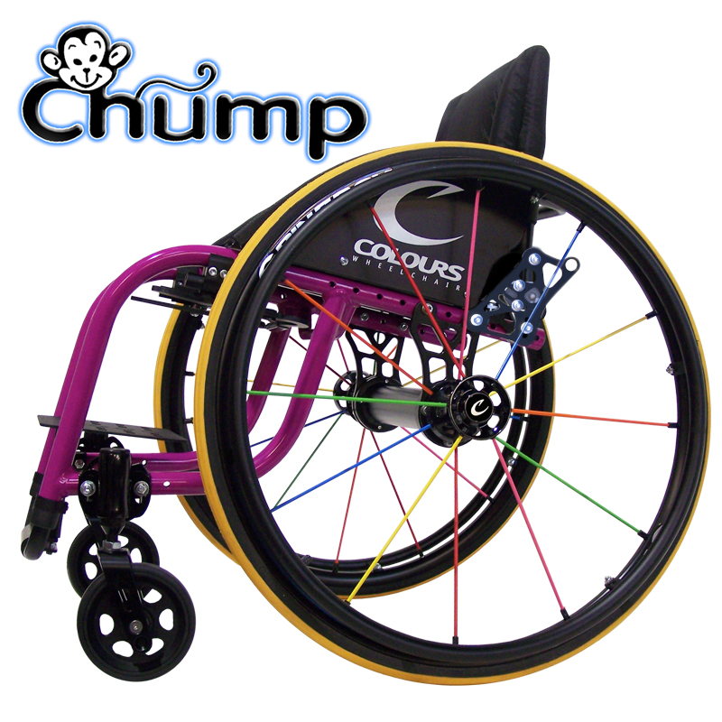
Colorus wheelchair
“Not just Another Wheelchair Company…It’s a Lifestyle!”
Colorus Wheelchairs come in all sorts of colors and designs. They have everyday chairs, kids chairs , folding chairs, sports chairs, and specialty chairs. These chairs are smaller in size compared to some of the other chairs.
Click here for more infromation
Notes:
I got to meet Ernie Espinoza VP of sales he passes on a lot of information. Then asked if I had ever sat in a wheelchair before. Of course I hadn't so I had told him. And he was in a bit of shock that us special education students were never told to sit in a wheelchair before. I first I thought it would be offender but after it really gave you a different perspective and outlook on how they view things. He was very positive and accepting of his condition.

Slide 6
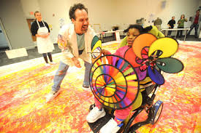
Zot Artz
“Zot Artz adaptive art tools for children with disabilities
Kids love making art. At Zot Artz, we design and make adaptive art tools so that children with disabilities can create huge, amazing art pieces. The Zot Artz tools and facilitated art events entertain and teach children at fairs, fundraisers, and festivals, or as part of everyday recreation, education, and therapy programs.”
Find more information here
Notes:
I had never seen anything like this before so this was very interesting. Its such great idea. Fun to know that they will be coming to wheelock at some point. The more people that know about resources such as this the better.

Slide 7
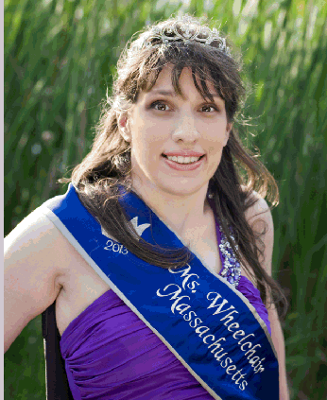
Ms. Wheelchair Massachusettes
“Ms. Wheelchair Massachusetts carries out her mission by educating leaders and local communities by promoting awareness, advocacy and change in public policy for individuals
with physical disabilities”
Not a typical beauty pageant it’s a search for the best spokesperson for the disabled community.
Find more information here
Notes:
Found this to be a good way for disabled women to voice what goes in their community so others can better understadn and respect them.

Slide 8
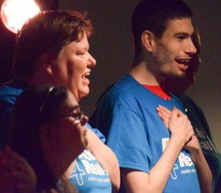
Reach 4 real
Reach 4 real is a music and theater program for people with different disabilities. In this program students create songs in pop and musical theater style, and they create and perform live performances for different types of audiences. Classes are available on and off site.
Click here for more information

Slide 9
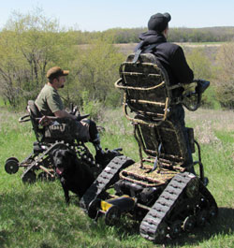
Action trackstander
“New Way to Stand”
Action trackstander is a wheelchair company that helps the disabled to be enabled. This company creates wheelchairs that can perform in different locations and settings. These chairs offer great traction for great adventures. These are great off road wheelchairs that can travel through different types of terrain.
Click here for more infromation
Notes:
Along with many of the other wheelchairs I never knew that they created wheelchairs like this. Its amazing how far technology has come and how many more experiences disabled people are able to experience because of this great technology

Slide 10
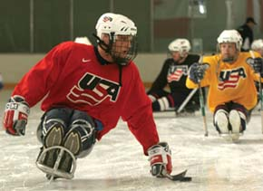
Northeast passage
“Living Beyond Disability”
Northeast Passage is a company that creates Adaptive sports and recreation programs and equipment. This program offers entry-level instruction, to casual instruction, to equipment rental, therapeutic recreation and competitive sports. Northeast Passage is out of New Hampshire.
Click here for more information
Notes:
Rental option is awesome. The northeast passage way is also pretty local located in Dover New Hampshire

Slide 11
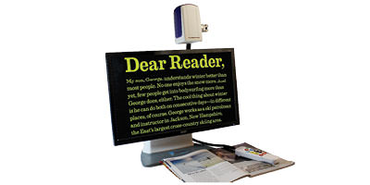
ONYX HD Portable Video Magnifier
The ONYX Deskset HD is a portable video magnifier that adapts to multiple environments. The camera has three in one views including distance, document, and self view. This camera allows you to read what you want where you want.
click here for more information
Notes:
Can help students with vision loss. Light weight so it can be carried to and from school. Can be used at home and in school

Slide 12
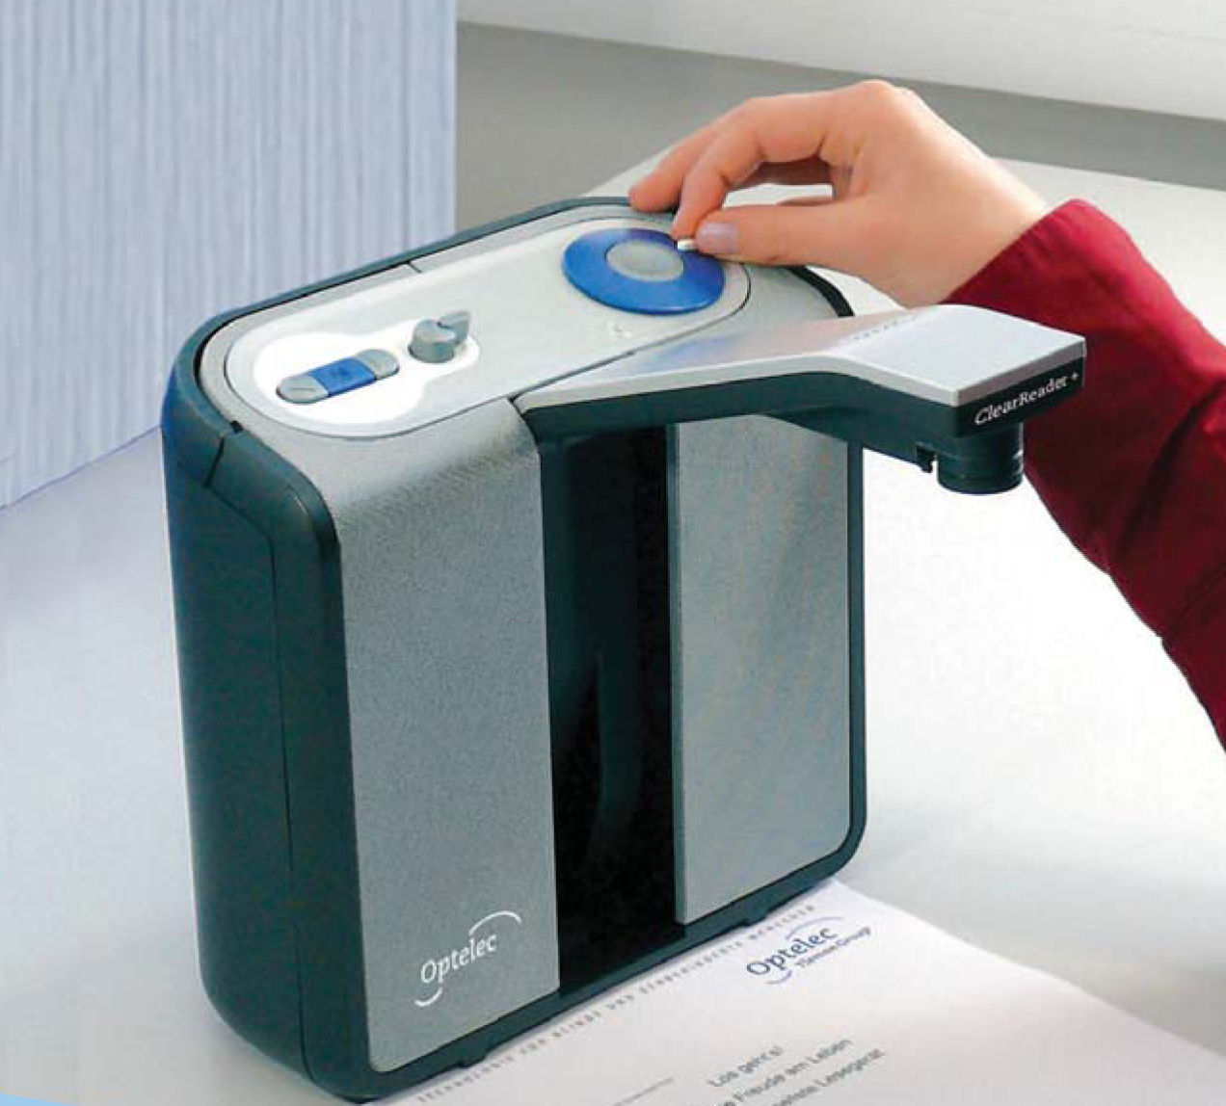
Optelec ClearReader
The Optelec ClearReader is a scanner that takes a screen shot of a text and then reads the text aloud in a clear high quality tone. The Optelec ClearReader offers 31 different languages.
click here for more information
Notes:
Great for students who are blind or do not know how to read. Allows many different languages

Slide 13
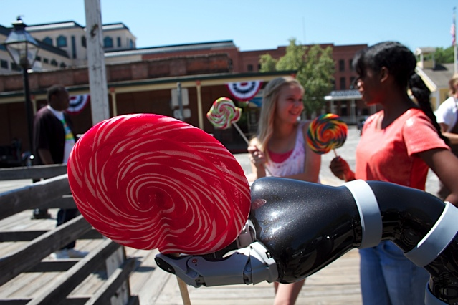
JACO Robotic Arm
The JACO Robotic Arm is an assistive robot arm that attaches to a power wheelchair. This particular robotic arm is designed for people who have upper body disabilities. Allowing them to perform a wide variety of tasks without assistance such as eating and drinking.
click here for more information

Slide 14
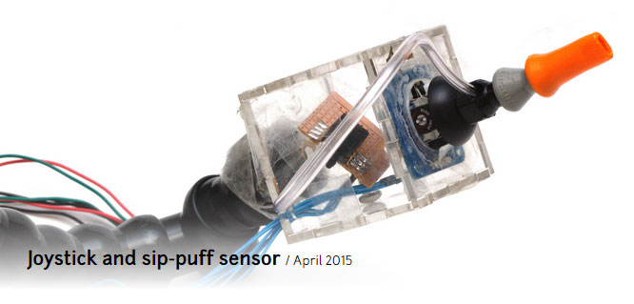
Puffin Joystick
The Puffin Joystick
A puffin is a mouth operated Bluetooth mouse. That allows for sip and puff capabilities in place or right and left clicks. This is a portable input device that is used by the mouth. This would allow people who do not have mobility of there hands to use a mobile device.
click here for more information

Slide 15
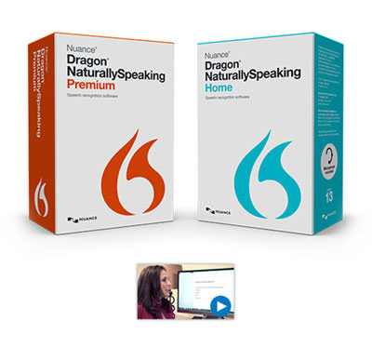
Dragon
The Dragon is a speech recognition software. This software lets you create documents, search the web, email and much more by simply using your voice.
click here for more information
Notes:
People and students who do not have mobility of there upper body could really benefit from this software. It would allow them to access many things online and on a computer through the use of their voice. I have never seen this software being used in a school but I feel it would be great option for younger kids to start to use and become familiar with where the technology is always improving it is important to familiarize all kids with technology

Slide 16
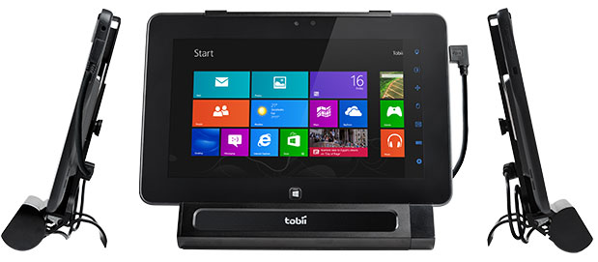
Tobii Products
Tobii products involve a variety of augmentative and alternative communication solutions that help individuals with speech impairments communicate. For example they have the Tobii EyeMobile this device allows for you to control a windows 8 tablet by using your eyes. Tobii also offers other communication devices.
click here for more information

Slide 17
Quartet Technology
Quartet products provide many types of products for the physically impaired.
click here for more information

Slide 18
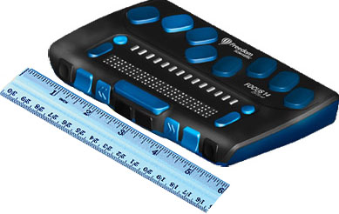
Focus Braille displays
There are three types of Focus Braille displays that offer many different features that allow you to access text messages, navigate your smart phone, send messages, takes notes, and much more.
click here for more information
Notes:
This is perfect for people who are blind. The device is small in size and allows for you to keep your mobile device in your pocket and still have access to it through the focus device

Slide 19
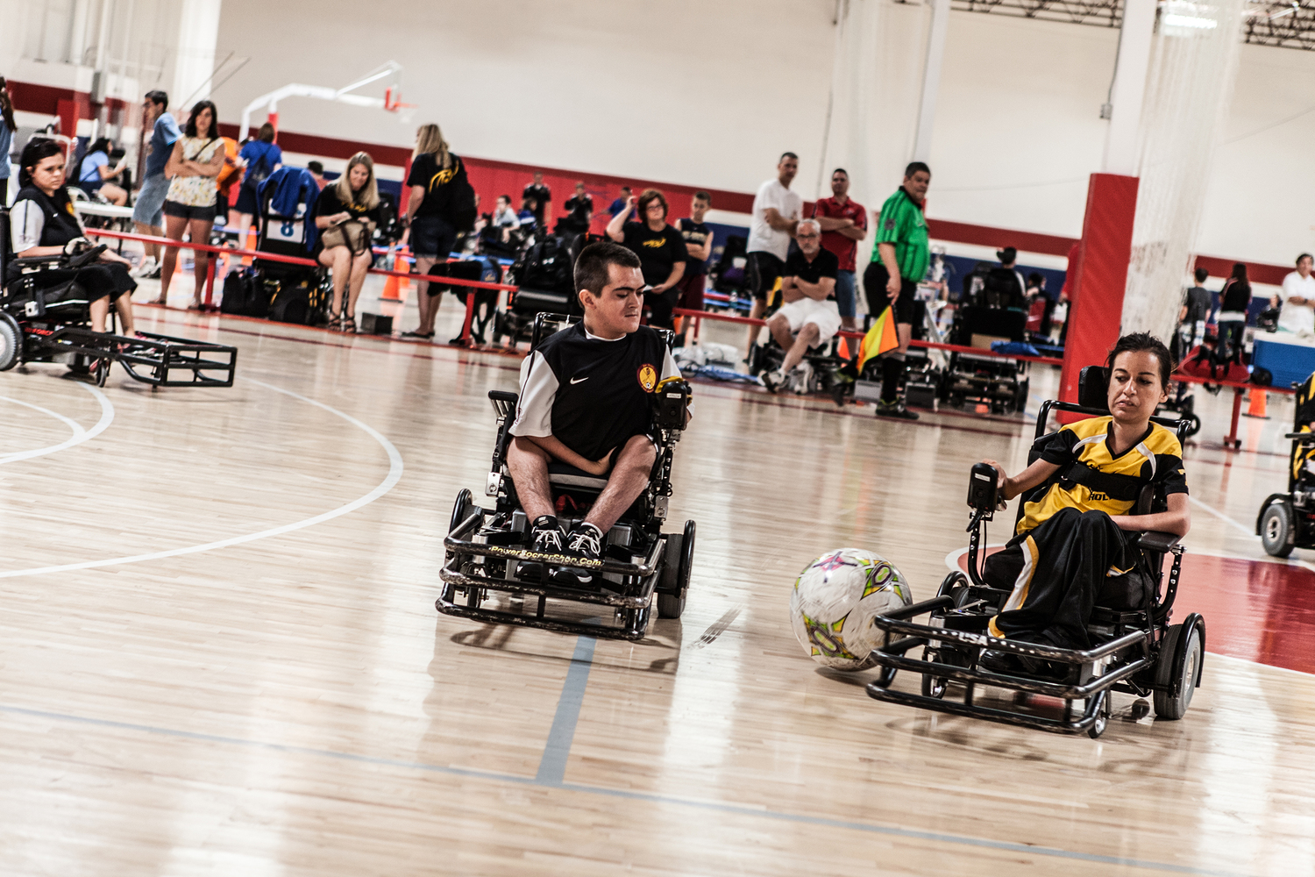
Power Soccer
Power soccer is the first competitive team sport that has been developed for power wheelchair users. Power soccer is played on regular a basketball court inside of a gymnasium. There are two teams with four players each. It requires a unique set of skills to play power soccer just as it does to play regular soccer.
click here for more information

Slide 20
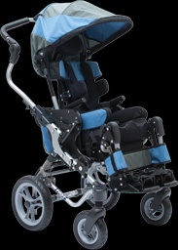
Quantum
Quantum is another high tech power wheelchair company. There are many different types of Quantum wheelchairs. Based on preference and needs people are able to pick out the perfect wheelchair from the wide range of options that are offered.
click here for more information
Notes:
I noticed on the Quantum website they have a a wheelchair that looks and folds just like a stroller would this chair is made for smaller children. It is called the kids fast wheelchair

Slide 21
My experience
Very informative
Engaging and hands on experiences
Good to talk to people in the assistive technology field
Gained a better understanding of assistive technology

