Slide 1
This Is How We Do It – Strategies For Preventing Challenging Behavior

Slide 2
If children don't know how to read we…teach!
If children don't know how to write we…teach!
If children don't know how to count we…teach!
If children don't know how to behave we…punish?

Slide 3
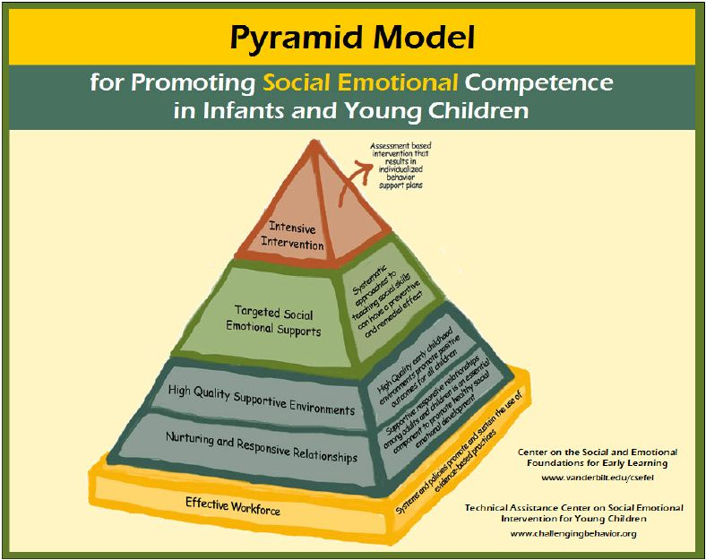

Slide 4
Tried and True
The successful strategies and philosophies we employ daily which have prevented challenging behaviors incorporate the following from the pyramid model:
  Nurturing and Responsive Relationships
  High Quality Supportive Environments
  Targeted Social Emotional Supports
Notes:
T Actively supporting engagement

Slide 5
  Nurturing and Responsive Relationships
WHY?
Inquiries made in this area discovered …
“The relationship between a child and their teacher directly contributes to a child’s engagement in school. “(Morrison,2007)
“If teachers show more positive emotion and sensitivity, and are less harsh and detached, young children are more likely to be engaged in the classroom.” (Ridley at al., 2000)
YES, it will take time and effort and YES it will interfere with instructional time however, much will be gained in the long run.
Notes:
J WHY is it critical to take the time and effort required to develop Nurturing and Responsive Relationships? Some may argue the fact that this takes away from precious instructional time.
Children notice responsive, caring adults and pay particular attention to what such a teacher says & does. They’ll seek out ways to ensure even more positive attention from the teacher. (Fox, et. al, 2003)

Slide 6
Nurturing and Responsive Relationships:
WHAT DO THEY LOOK LIKE & HOW DO I DO IT?
“The little things really do mean a lot”
A smile, a high-five, pat on the back, a hug.
LISTEN and acknowledge what the child has shared!
(Specific praise and feedback)
LEARN about the child’s interests, fears, family members, pets.
Talk to the children you teach and share things about yourself.
The dialog is informal and often spontaneous! Not “teacher planned” it occurs naturally.
Nurturing and responsive relationships will contribute to building and supporting your classroom community which
will lead to student engagement!!
Notes:
T: We believe the classroom climate begins with our own attitude and beliefs…now with that being said we all have our “own” thoughts as to what a “nurturing and responsive relationship looks like.” Is someone willing to share their thoughts?
WAIT…..
T: “Please take a look at the picture and tell me what you see”…SHARE OUT… Next go over each item in the box.
T: “Family members/Braedon & his grandparents visiting the classroom.”
Connections are deepened when we get directly involved with what the children are doing…especially when the activity is child directed…great time to model positive approaches to learning, problem solving, play skills, etc.

Slide 7
Our thoughts
We believe the classroom climate begins with our own attitude and beliefs.
Our reactions to daily events and stress dictate the mood of our classrooms.
We are one of the most powerful models for students in how we talk to and interact with others.
Identify triggers and choose your battles! Remember…Rome was not built in a day!!
Instruction and interventions are a priority reflecting the needs of the children and the classroom.
Notes:
T Our reactions to daily events and stress dictate the mood of our classrooms. Gracie
Identify triggers and choose your battles! Remember…Rome was not built in a day!! Jeremy
Interventions: “You can’t have one without the other.”

Slide 8
High Quality Supportive
Environments
Creating our classroom communities:
Create an atmosphere for students and families where they can feel accepted, acknowledged, and appreciated.
Taking the time to establish a relationship with students and families
Learning about strengths, weaknesses, preferences, and strategies
    Ecological
    Meet & Greet/Open House
    Welcome letter
    Phone and Face-to-Face Conferences
Notes:
JO CLAIRE
Establish relationships – starting with how we greet the children every day – smile, eye contact, touching; model language we want used with other students….(Aiden story)
Conscious Discipline: brain – back seat/front seat analogy (GRAPHIC?)
Tiffany: conferences….the parent that just “SHOWS UP”

Slide 9
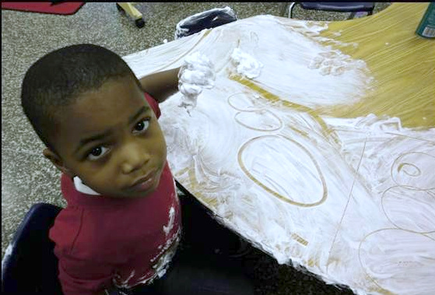
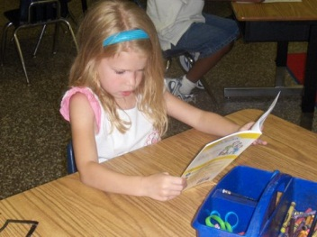
Our High Quality Supportive Environments…
Celebrate small accomplishments
Promote independence and generalization.

Slide 11
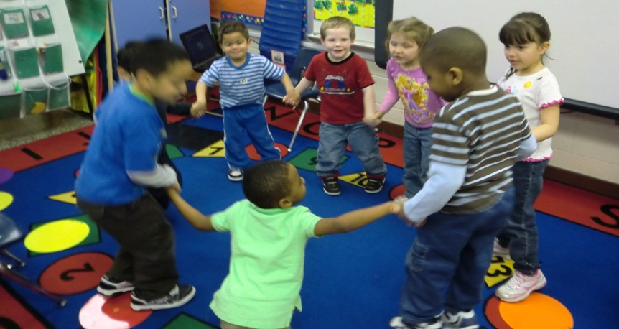
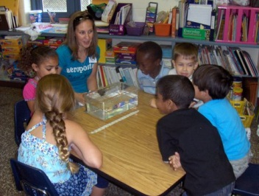
Fostering an interdependence among students in the classroom
Maintaining our classroom communities by collaborating with and involving families throughout the year

Slide 12
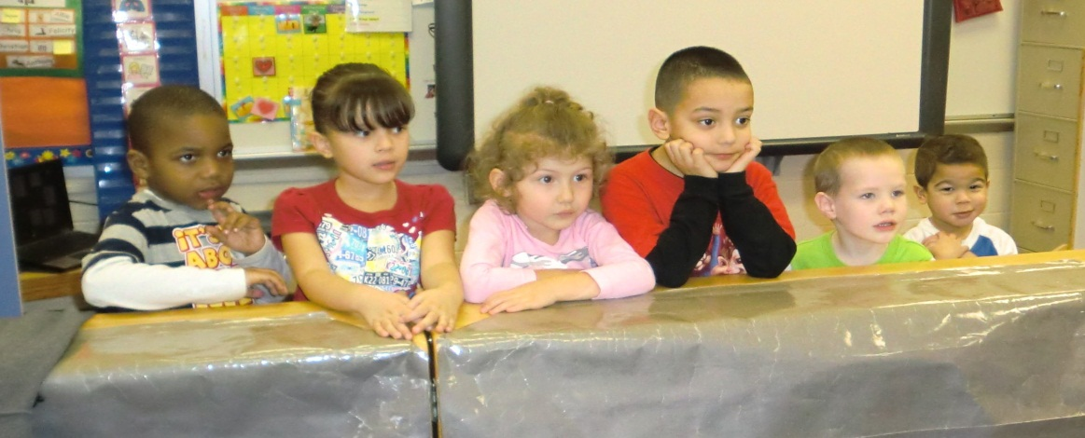
High Quality Supportive Environments
Physical room arrangement
  Schedules
  Teaching routines from the beginning of the year
    And reteach, again, and again!!
    Model….model again….model again……and be patient

Slide 13
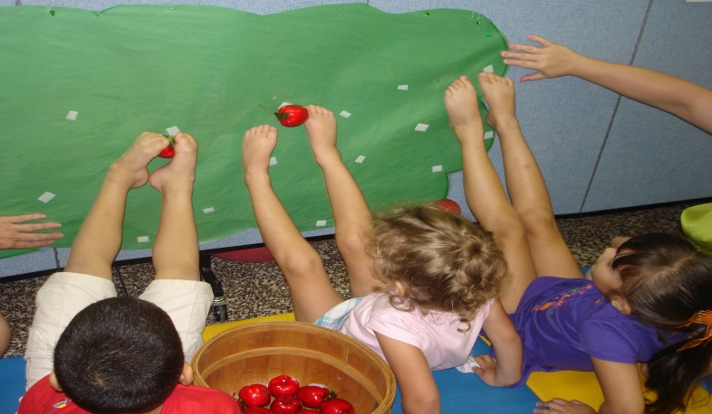
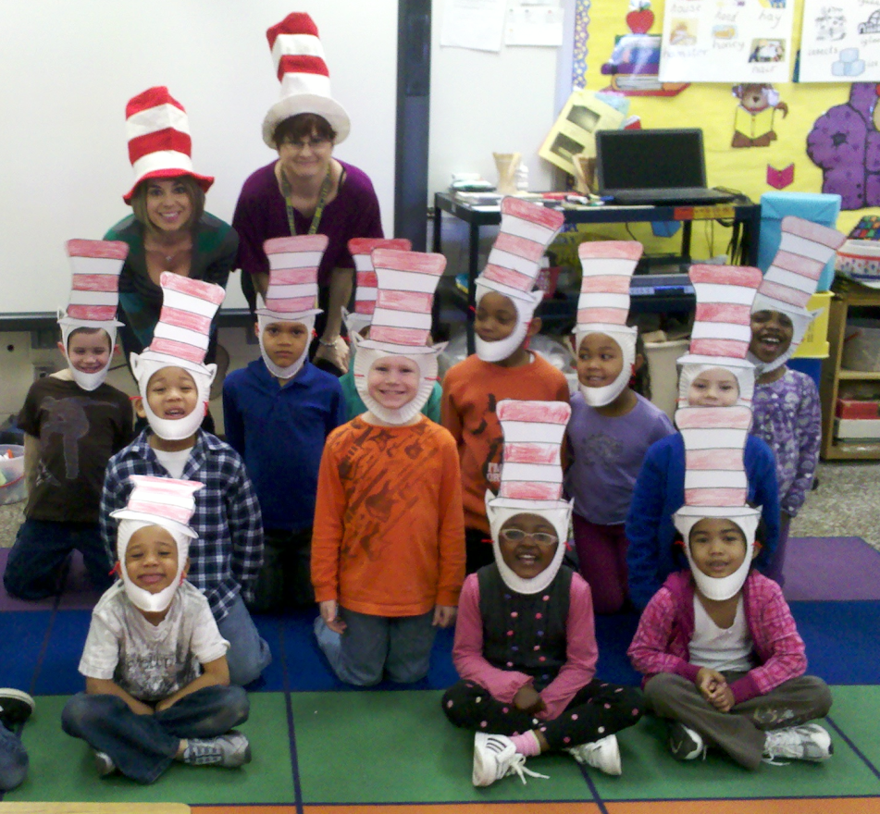
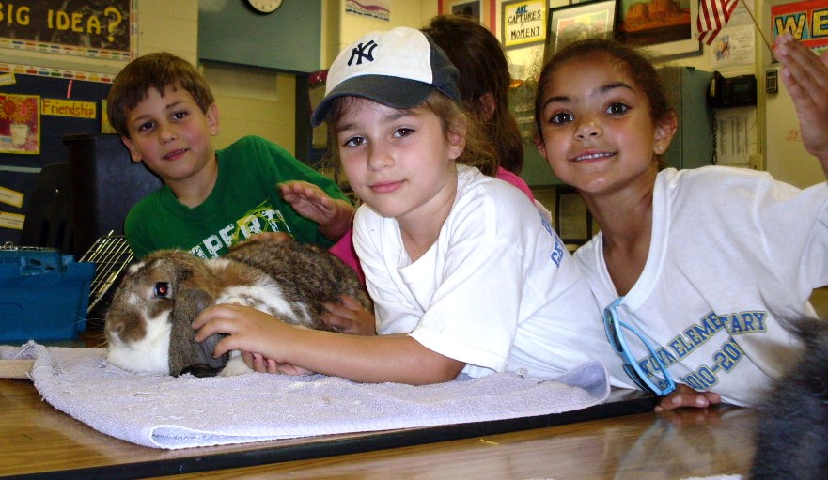
Planning and providing children with engaging activities
Praise/Correction Ratio: 5:1
Having a system /routine for positive and negative behavior.
BE CONSISTENT

Slide 14
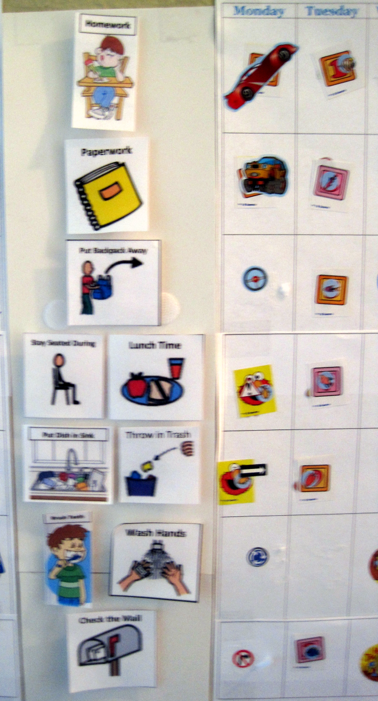
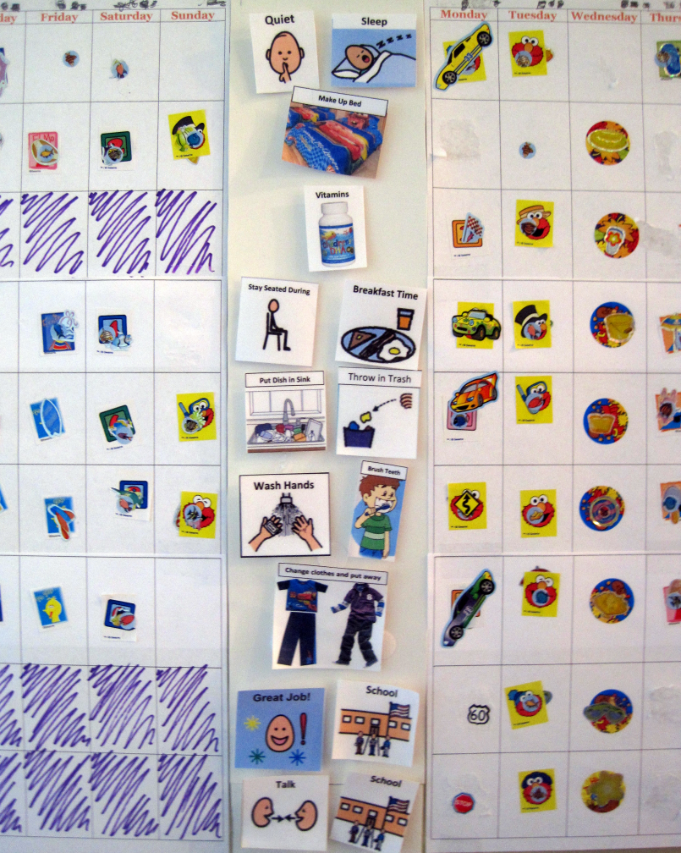
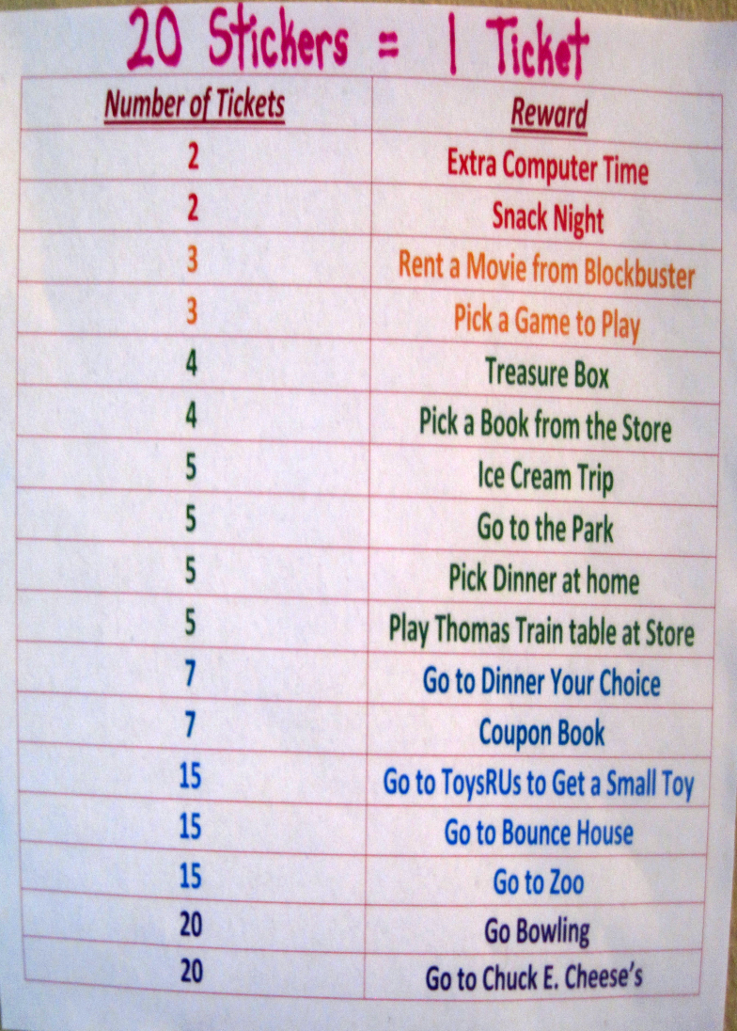
Collaborating and providing families with information to empower them and to provide the most supportive environment at home as possible.

Slide 15
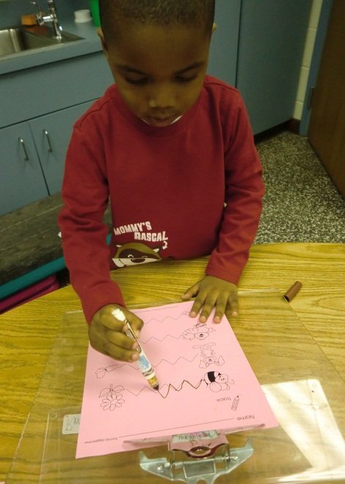
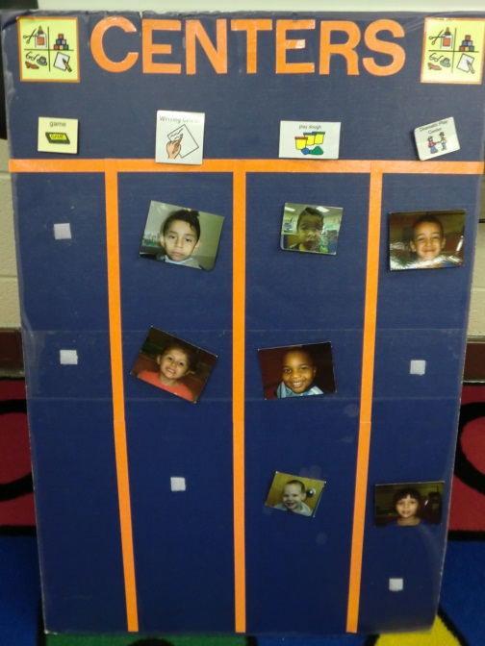
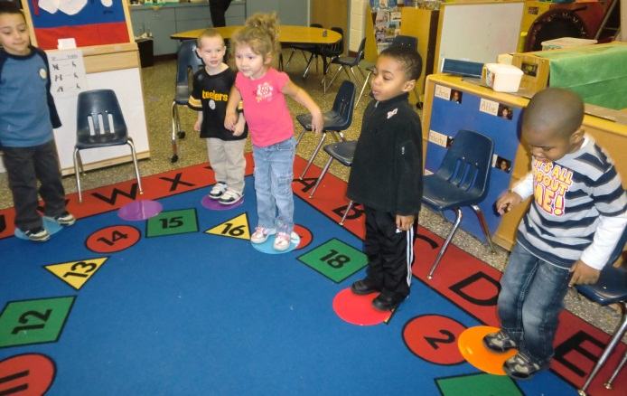
Modifications/Adaptations to the Environment, Activities, and Expectations
Environment

Slide 16
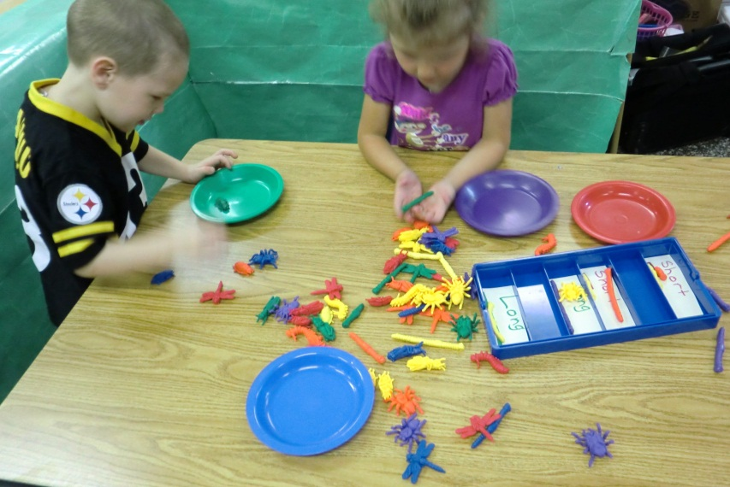
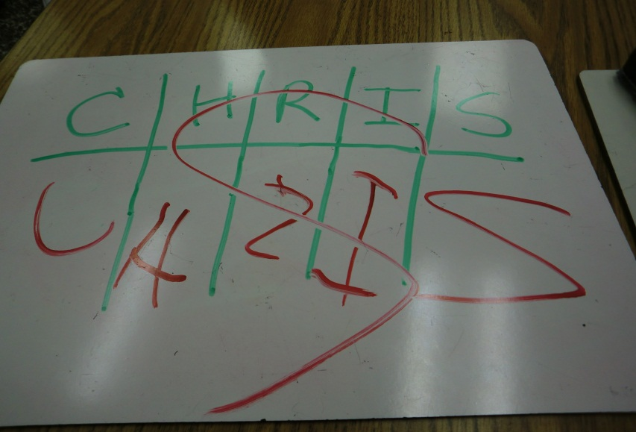
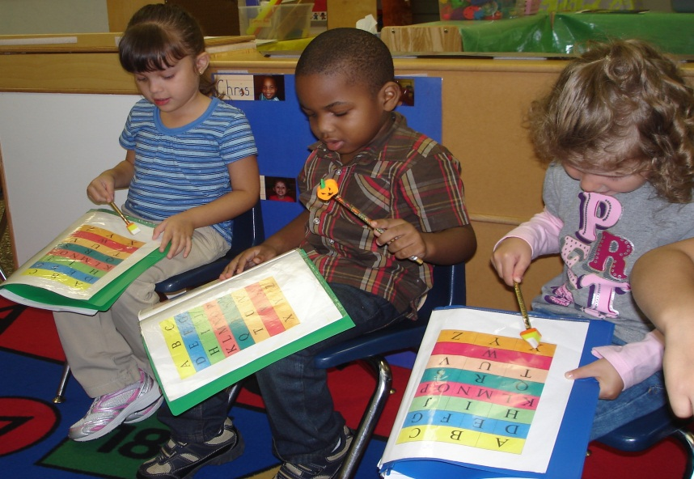
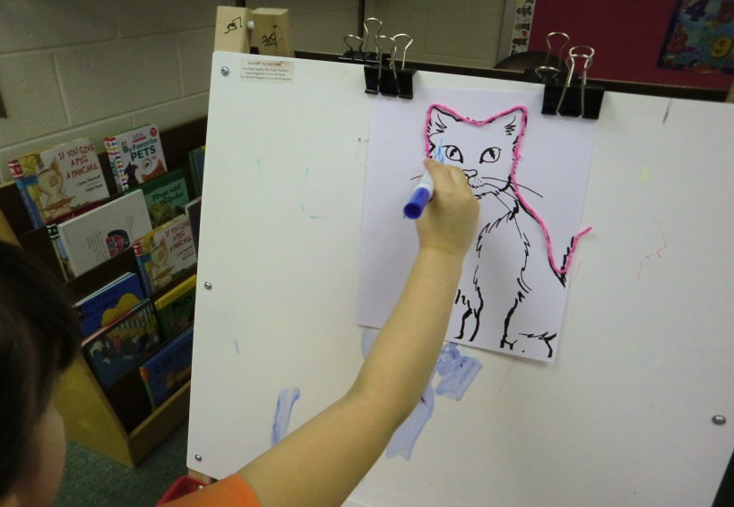
Activities

Slide 17
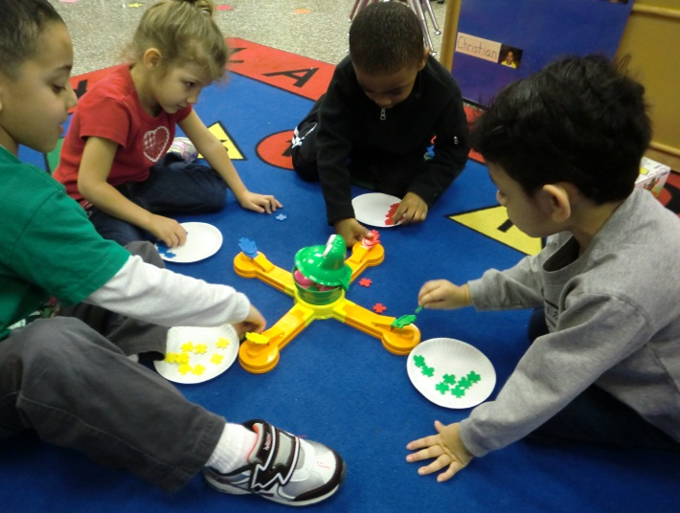
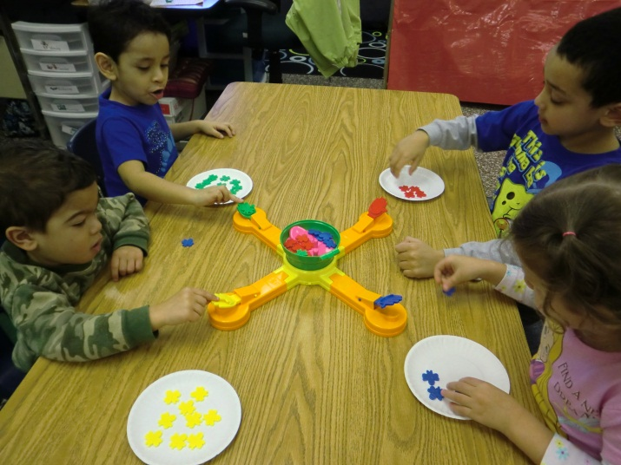
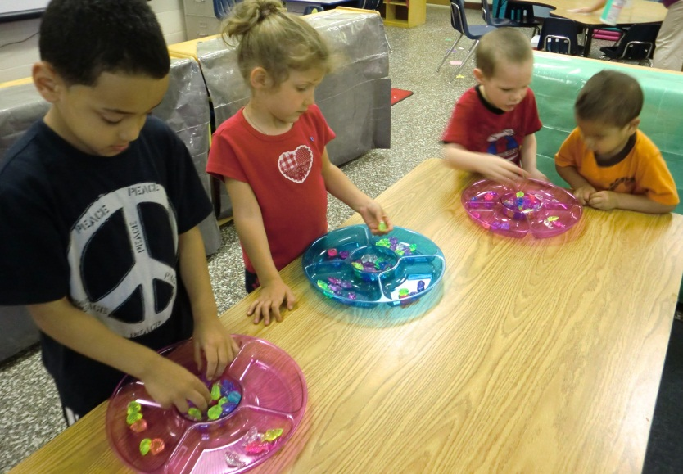
Expectations

Slide 18
Targeted Social Emotional Supports
Some children need more intentional support than basic attitudes, plans and routines can provide.
Strategies include:
modifications/adaptations to the environment, activities, and expectations
using social stories
using visuals
employing “student helpers” or peer buddies
using more individualized behavior systems

Slide 19
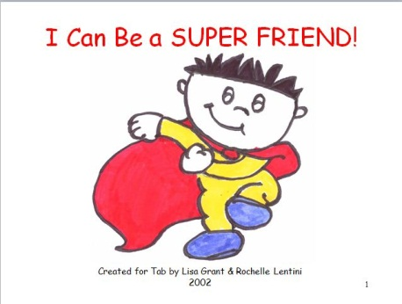
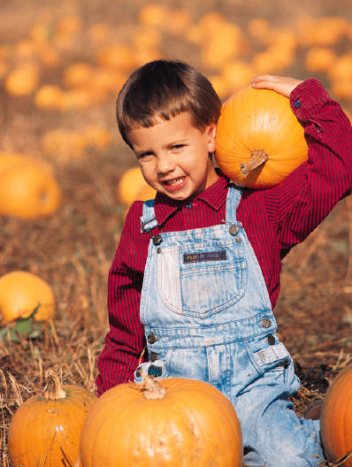
Using Social Stories
Store bought or teacher/parent made
Books about
  Feelings
  How to do something
  How to react to/handle a situation
  Following rules
Going to the Pumpkin Patch

Slide 20
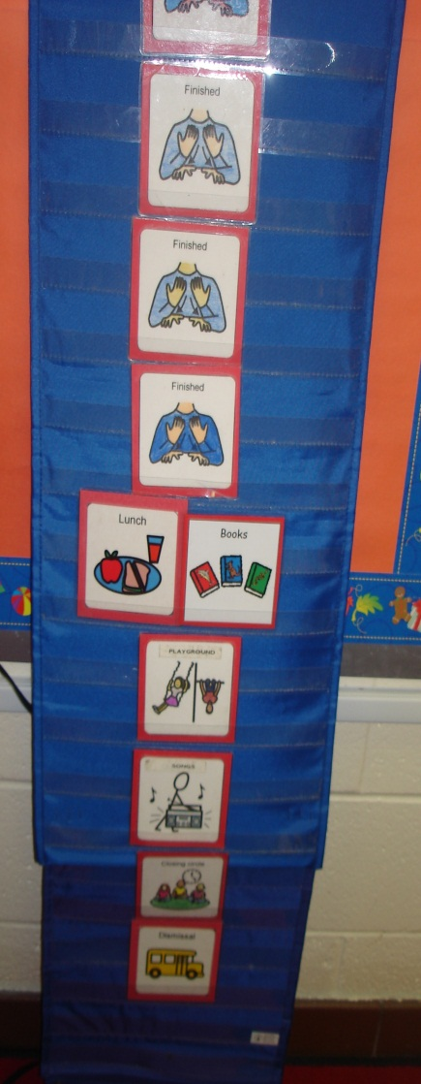
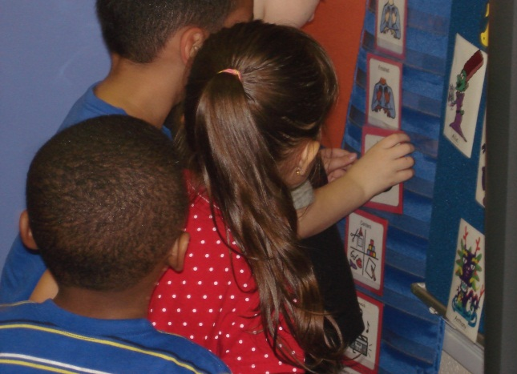
Using Visuals
Objects, Real Photos, Line Drawings
  Developmental Age Guidelines:
    Below 12 months: Tangible Objects
    12-18 months: Real Photos
    18 months & Up: Line Drawings
Schedules
  Master schedule
  Individual Schedule
  Mini schedules

Slide 21
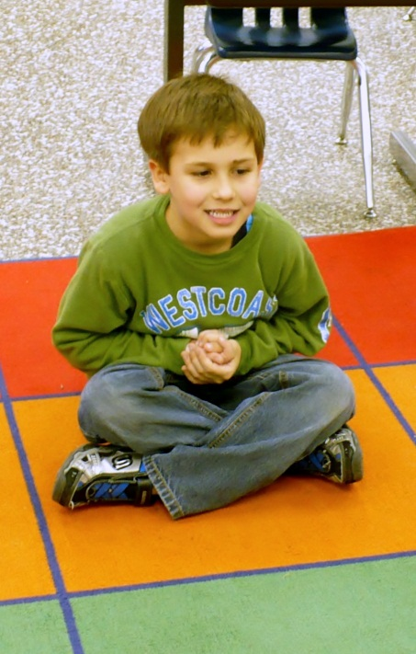
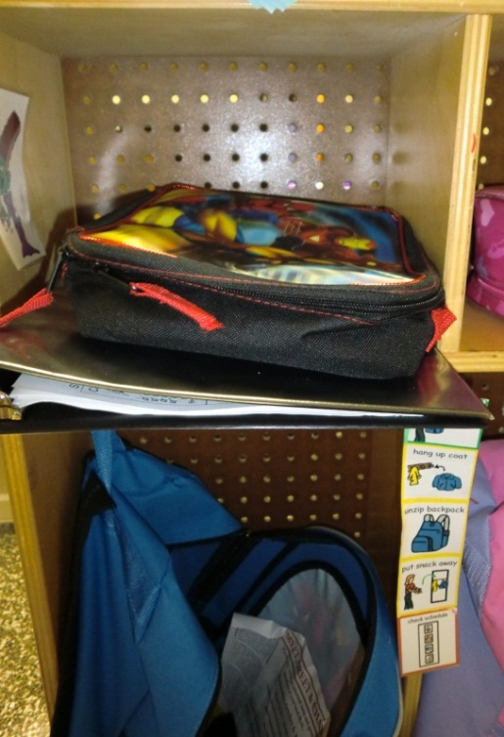
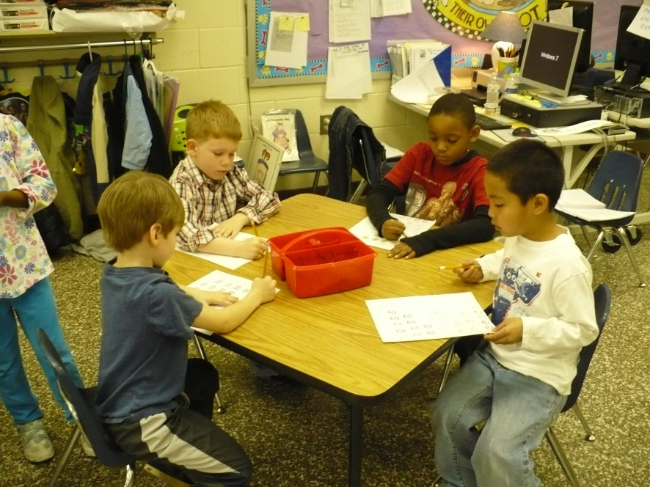
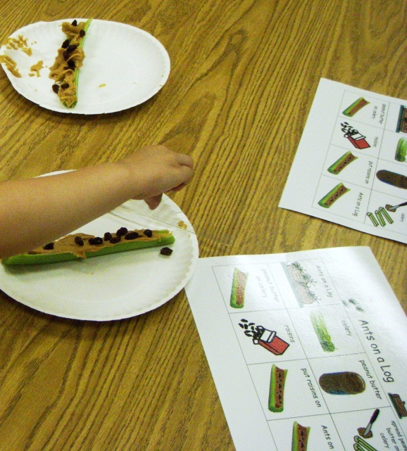
Directions/Expectations
  Mini schedules
  Picture cues
  Directions for an activity
  Pictures to show expectations & facilitate play within centers

Slide 22
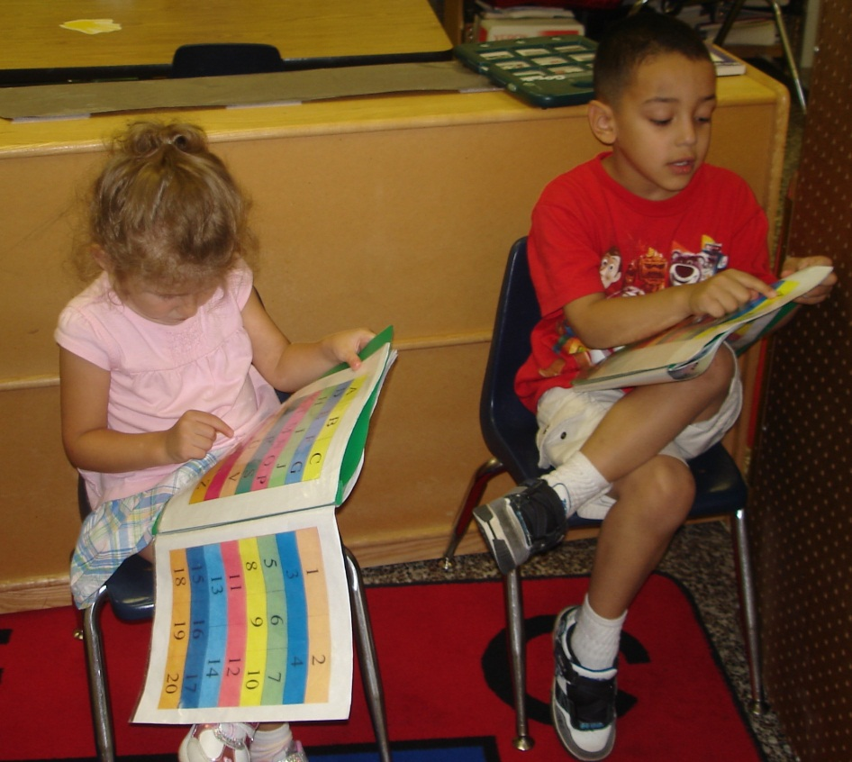
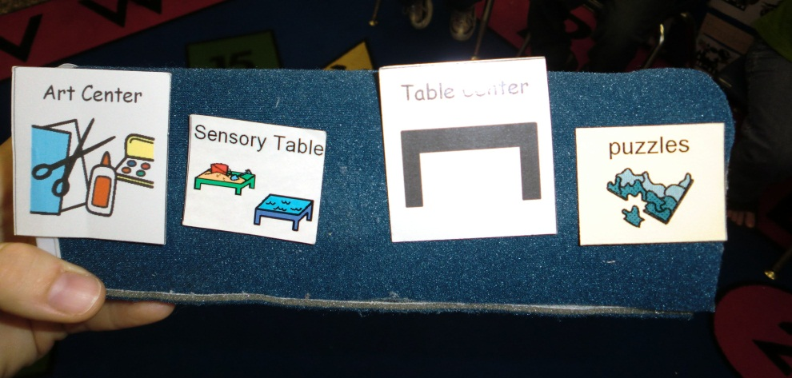
Explain concepts
Identify feelings on others and self
Choices
To facilitate participation

Slide 23
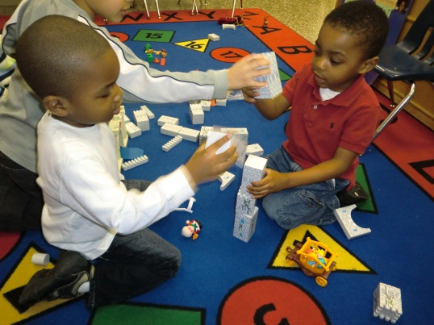
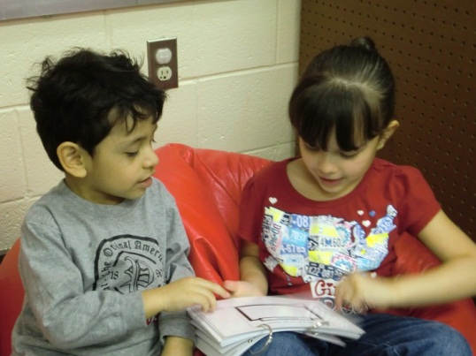
Employing Student Helpers/Peer Buddies
Student Jobs
Only asked to help with tasks we have modeled/can walk them through or they can independently do
Student Helper gains
confidence
Child being helped completes the task/skill without adult intervention

Slide 24
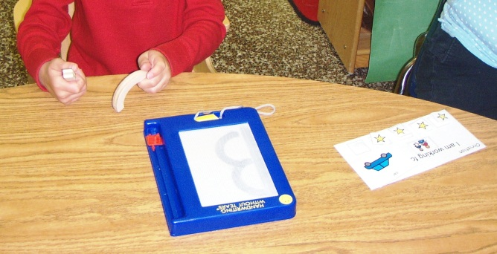
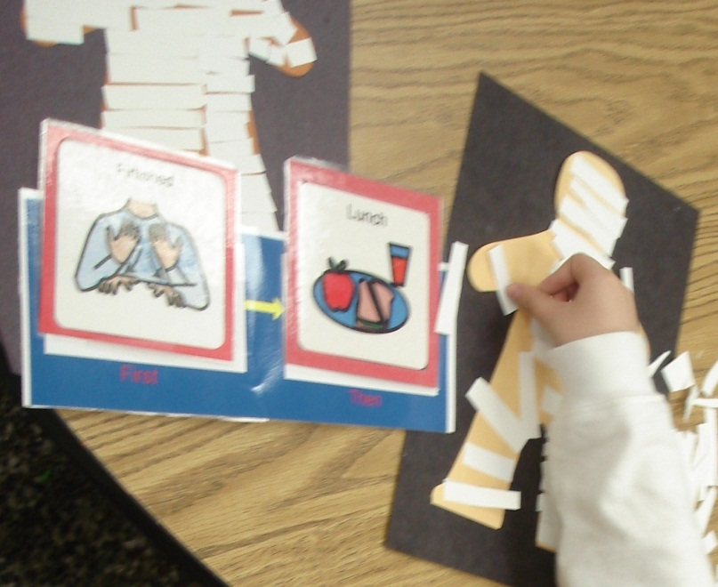
Using More Individualized Behavior Systems
First-Then
Putting reinforcement into a schedule
Token Reinforcement Systems – children earn “something” e.g. pennies, stars, etc. for a student pre-selected reward
  Modification for younger children: picture puzzle

Slide 25
“The key implication here is that most solutions to challenging behaviors are likely to be found by examining adult behavior and overall classroom practice, not by singling out individual children for specialized intervention.”
(Fox et al. 2003)

Slide 26
References
Fox, L. (2003). The Teaching Pyramid: A model for supporting social competence and preventing challenging behavior in young children. Young Children , 48-53.
Hyson, M. (2008). Enthusiastic and Engaged Learners Approaches to Learning in the Early Childhood Classroom. New York: Teachers College.
Morrison, F. (2007). Contemporary Perspectives on Children's Engagement in Learning. Society for Research in Child Development. Boston.
Ridley, S. (2000). Observed engagement as an indicator of child care program quality. Early Education and Development , 133-146.

Slide 27
Websites We Love
Sites for Social Stories
http://www.kansasasd.com/node/9 - Kansas Instructional Support Network
http://kidscandream.webs.com/page13.htm
http://www.speakingofspeech.com/ - stories are in the Materials Exchange area
http://www.sandbox-learning.com/ - personalized social stories for a fee
Sites for Visuals
http://www.patrickecker.org/
http://www.polyxo.com/visualsupport/
http://www.setbc.org/pictureset/ - British spellings
http://www.do2learn.com/picturecards/printcards/index.htm

Slide 28

Looking for more?
http://csefel.vanderbilt.edu - Center on the Social and Emotional Foundations for Early Learning (CSEFEL)
http://www.challengingbehavior.org/index.htm - Technical Assistance Center on Social Emotional Intervention for Young Children (TACSEI)
http://consciousdiscipline.com
http://prekese.dadeschools.net/consciousdiscipline.html
Songs for I Love You Rituals: Vol.1
Available at www.consciousdiscipline.com or www.amazon.com

