Slide 1
Apps as Assistive Technology
Mobile Device Applications for Individuals with Disabilities

Slide 2
What is Assistive Technology?
Assistive technology (AT) is “any kind of technology that can be used to enhance the functional independence of a person with a disability.”^{[1]}
Assistive technology is anything that helps you do something that you couldn’t do before.
[1] The family Center on Technology and Disability Fact Sheet: Assistive Technology 101

Slide 3
Assistive Technology Devices
AT devices are “tools to help to overcome challenges and enable people living with disabilities to enhance their quality of life and lead more independent lives.”
We tend to think of these tools as advanced, high-tech electronics. However, these tools are on a continuum, ranging from high-tech tools (such as electronics and computers) to low-tech tools (such as pencil grips and highlighters).

Slide 4
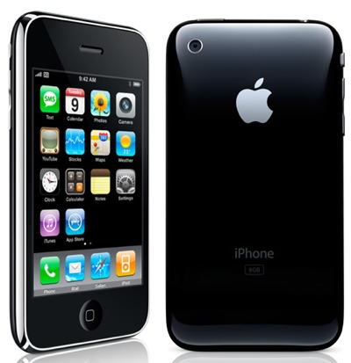
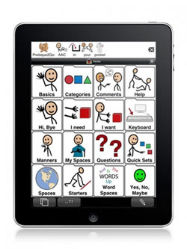
Assistive Technology & Apps

Slide 5
There’s an app for that.
Increasingly, apps for the iPhone, iPad, Android, or other smart phones or tablets are showing up that enhance and ease every day life functioning; these include apps to assist people with disabilities.
These apps range from simple and free apps to help teach spelling, to advanced and often expensive apps that function as Augmented and Alternative Communication devices.

Slide 6
There’s an app for that.
Apps may be especially relevant to helping students with disabilities learn: students with autism or ADHD may benefit from the use of novel and stimulating technology, and students with physical impairments may benefit from the ease of access to the apps.
AT apps are specifically designed to help improve every day life functioning and learning for students with disabilties.

Slide 7
Links to Lists of AT Apps for Individuals with Disabilities
Madalaine Pugliese composed this list of Apps into groups in accordance with the steps of the Stages© framework – she also describes how to select the right application for the individual child’s needs.
iPhone and iPod touch Apps for Special Education
App Gallery for noteworthy apps for individuals on the autism spectrum.
A collection of apps for special education.

Slide 8
Apple’s iTunes has a collection of apps for special education in its Apple Store.
These are sorted into the categories of:
Sign Language
Communication
Diagnostics & References
Emotional Development
Seeing & Hearing
Language Development
Literacy & Learning
Organization
Life Skills
All of these assistive technology apps help to further the functional independence of individuals in some way.

Slide 9
Examples
Of Assistive Technology Apps for the iPhone and iPad

Slide 10
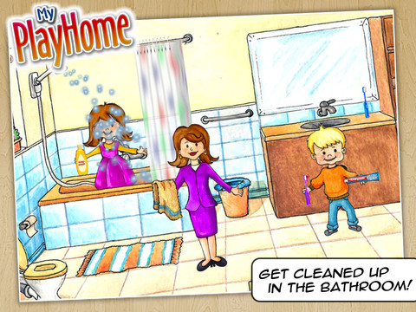
My PlayHome
“Navigate through different rooms of the house as your child makes different members of the family do things. The adult can give students directions or users can give each other directions, having family members do different things and manipulate objects in the house.”
Good to model for children appropriate behavior, life skills, and social stories. Fun and interactive to promote motivation!

Slide 11

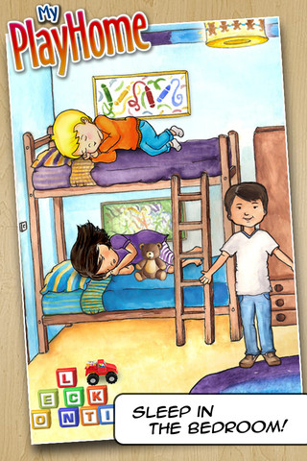
$3.99
By Shimon Young

Slide 12
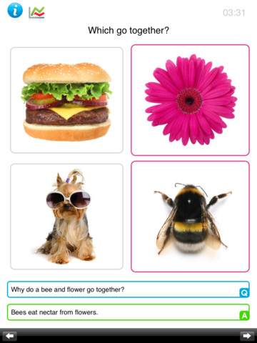
Which Go Together?
“Which Go Together?” is an ABA problem solving game to teach the skill of categorizing of items. The child problem solves and figures out which item goes together using bright and colorful images.
This app is “used by educators and speech language pathologists worldwide” and can assist in teaching students speech, language, and grouping and categorizing skills.
Real pictures are a fun stimulus for all children!

Slide 13
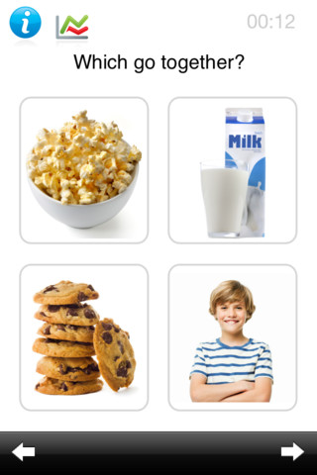
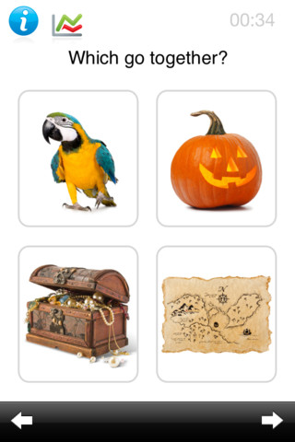
$1.99
By Kindergarten.com

Slide 14
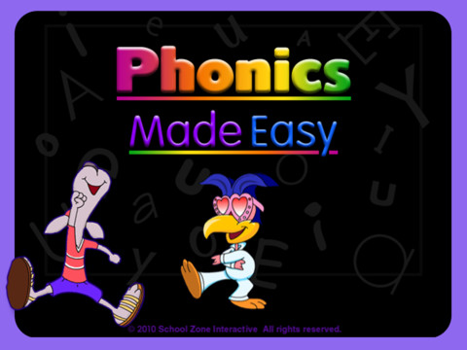
Phonics Made Easy
“Phonics Made Easy Flash Action iPad app has been developed to help children sharpen important phonics skills for reading success. Children will explore beginning and ending letter sounds, distinguish between long and short vowel sounds, pinpoint the rhyming families, work with letter blends, and more.”
Fun and interactive games will keep the attention of all children as they learn these reading basics.

Slide 15
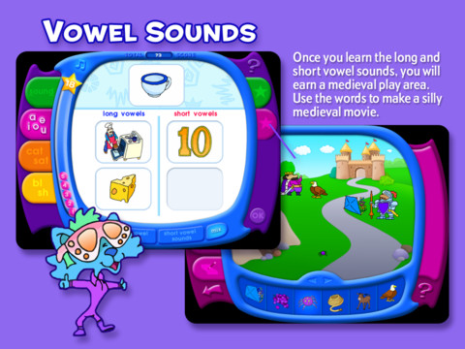
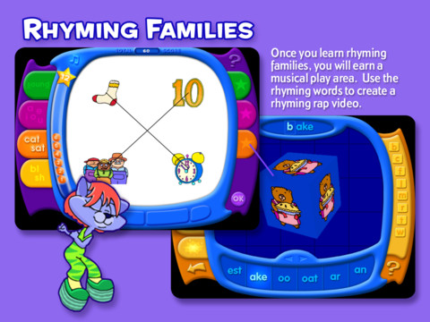
$4.99
By School Zone Publishing

Slide 16
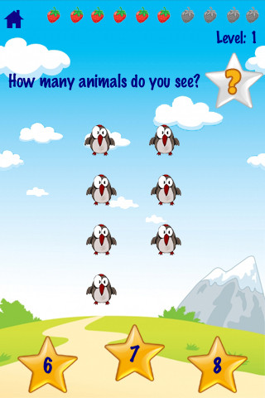
123 Animals Counting
“Teaches toddler and young kids VISUALLY and VOCALLY how to COUNT with fun animated animals and touch screen interactions.”
Touch 40 different animals with sounds to see and hear numbers counted.
Good for children with auditory impairments or who require novelty in learning.

Slide 17
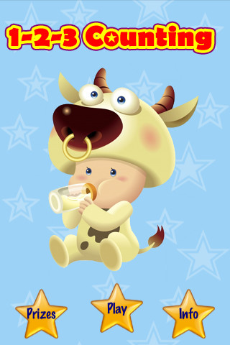

$1.99
By Brain Counts

Slide 18
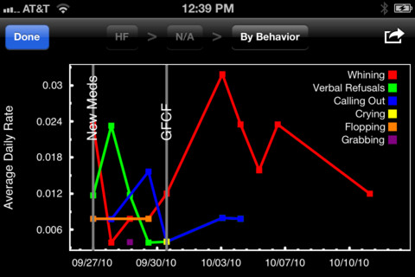
Behavior Tracker Pro
“Behavior Tracker Pro for Autism is an iPhone, iTouch and iPad application that allows BCBAs, behavioral therapists, aides, teachers or parents to track behaviors.”
This app can be used to track ABC data, frequency and duration, and high frequency data, and automatically graph them.

Slide 19
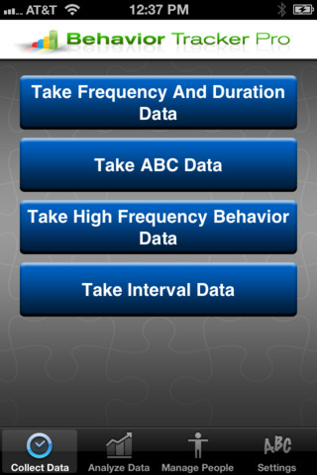
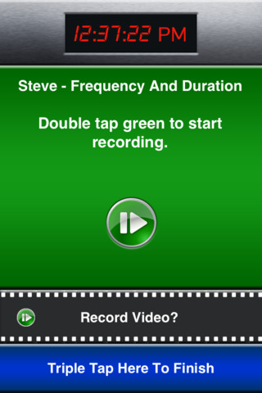
$29.99
By Marz Consulting Inc.

Slide 20
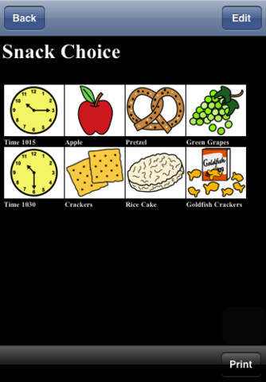
iCommunicate
“iCommunicate lets you design visual schedules, storyboards, communication boards, routines, flash cards, choice boards, speech cards, and more. It is customizable to your needs.“
In the app iCommunicate, pre-loaded pictures and storyboards/routines (e.g.,
schedule) facilitate language comprehension and enhance communication.

Slide 21
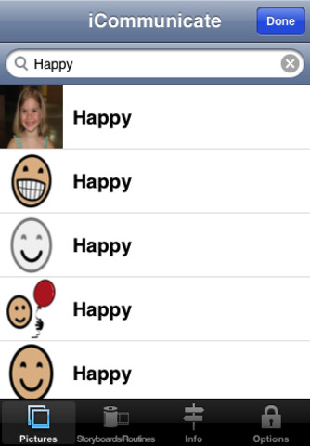
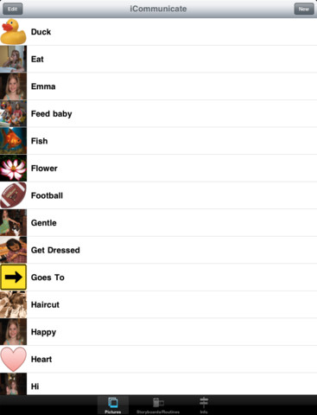
$49.99
By Grembe Inc.

Slide 22
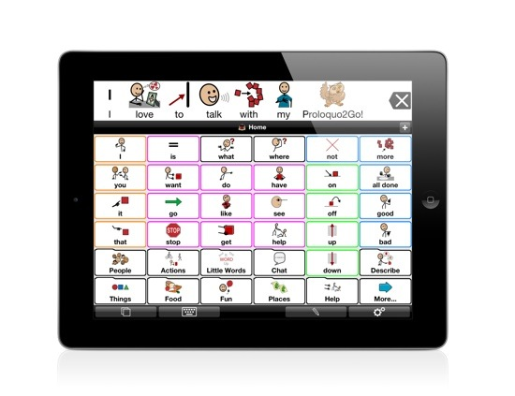
Proloquo2Go
“Proloquo2Go™ is an award-winning Augmentative and Alternative Communication (AAC) solution for iPad, iPhone and iPod touch for people who have difficulty speaking or cannot speak at all.”
Great for students with communication disorders, including children on the autism spectrum.

Slide 23
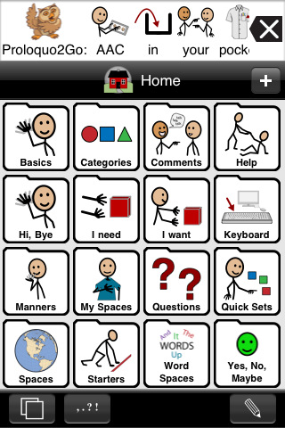
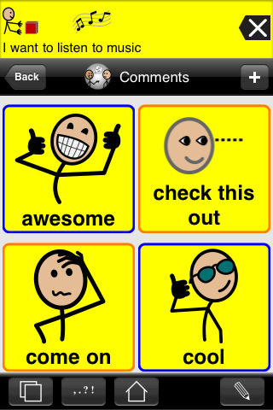
$189.99
By AssistiveWare

