Slide 1
Abilities Expo 2015
Kayla Grosso
SPE 710 Assistive Technology
Gina Stefanini
Due: October 2, 2015

Slide 2
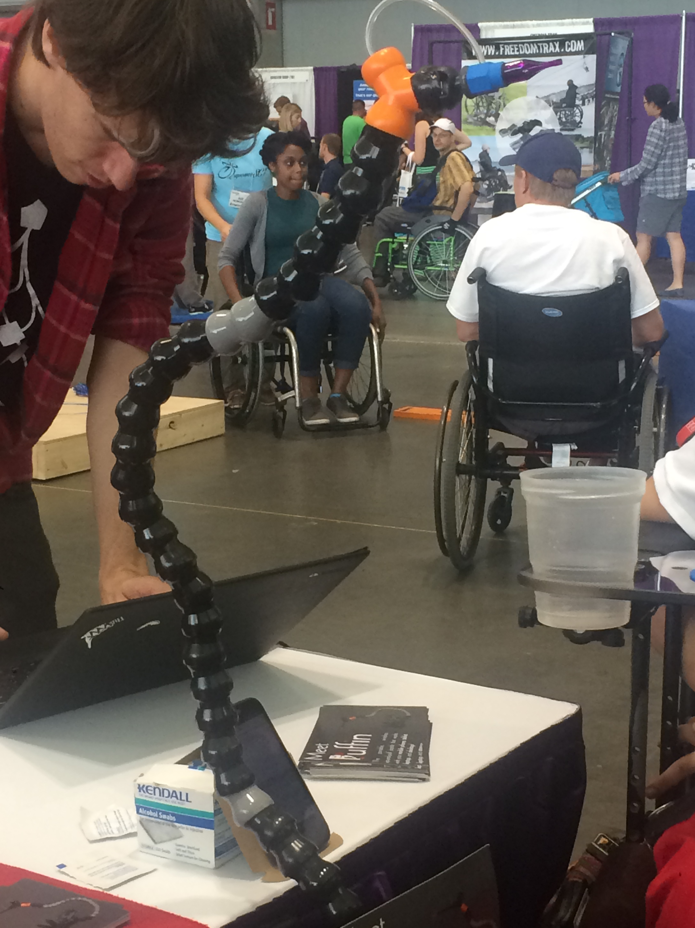
Puffin
This is a portable, wireless, sip and puff joystick that works with your mobile phone, tablet, laptop, and desktop.
Click here for a short video on creator and use of Puffin
Notes:
I love the idea of this. It allows individuals to be able to use a smartphone and other common devices. Nearly all of us in our initial blog posts talked about devices such as smartphones, computers, and tablets in our use of technology every day. I think this device will allow many who have very little motor abilities to be able to use many more assistive technological devices.

Slide 3
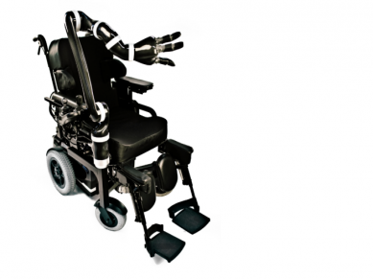
JACO Robotic Arm
This robotic arm was formed in order to help people perform a wide variety of tasks without assistance such as eating or drinking. It is used through an existing wheelchair controller and it can retrieve objects from nearly every angle, including the floor.
(click play button to watch video – on the left)
Notes:
I found this product to be one of the more interesting products. I always think about how much independence people have or could have and I think this is incredibly helpful in assisting individuals that are wheelchair bound or have very few motor functions. My guess is that this product along with many others that I saw at the expo is probably very expensive to own, however powerful in allowing individuals to have their own sense of independence with small tasks such as pouring your own drink and drinking from your glass on your own.

Slide 4
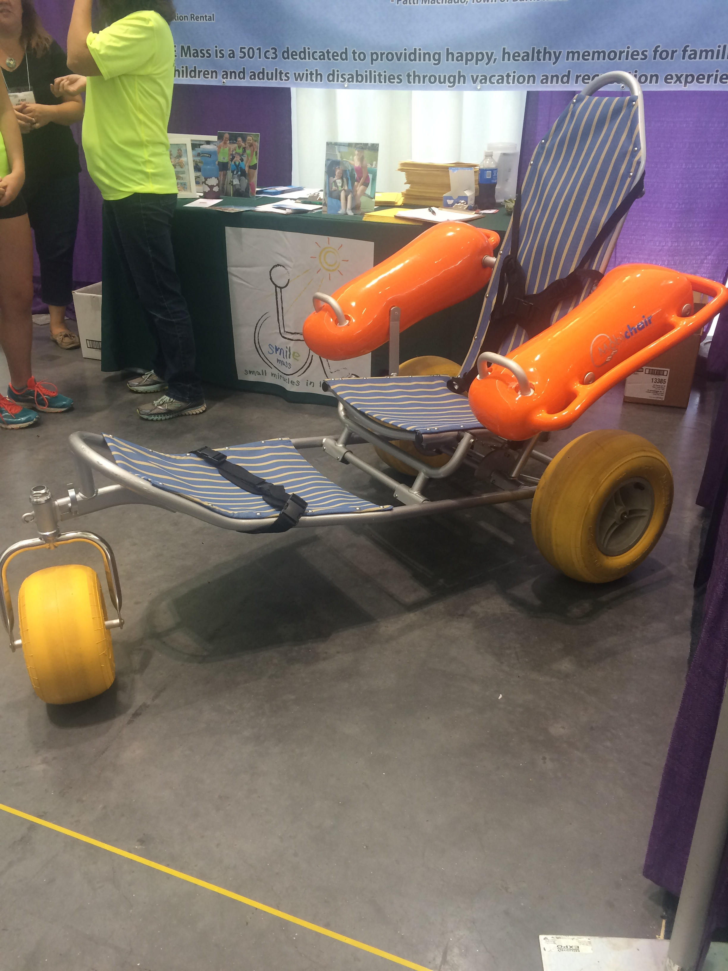
Floating Beach Wheelchair
This company is a program that loans beach wheelchairs to those that are wheelchair bound for free! This chair is able to easily move through the sand and it also floats in the water so you can swim! This company also has jogging strollers, jogging chairs, adapted bicycles, and kick sleds.
Notes:
This piece of technology is wonderful for people to be able to experience the beach and nature. The beach is something not necessary for everyday life but it is a pleasure that I personally enjoy. I think being able to go to the beach is a wonderful thing and the fact that this product allows people to get into the water is awesome as well.

Slide 5
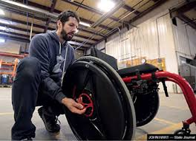
ROWHEELS REV
Click here for a video on how rowheels rev works
ROWHEELS REV Video
This product is poised to revolutionize manual wheelchair propulsion. Its hub design reverses the motion and corresponding forces required to propel a wheelchair, allowing users to PULL the hand rim to drive the wheelchair forward.
Notes:
This product is helpful for wheelchair users because it is ergonomically correct. This means that it is better for your body and less straining on your body overtime. The other wonderful thing about this product is that it is not an entire wheelchair, it is simply wheels that can be installed to whatever wheelchair you are using. I think this is a great invention for people who are reliant on a wheelchair to move around and navigate places.

Slide 6
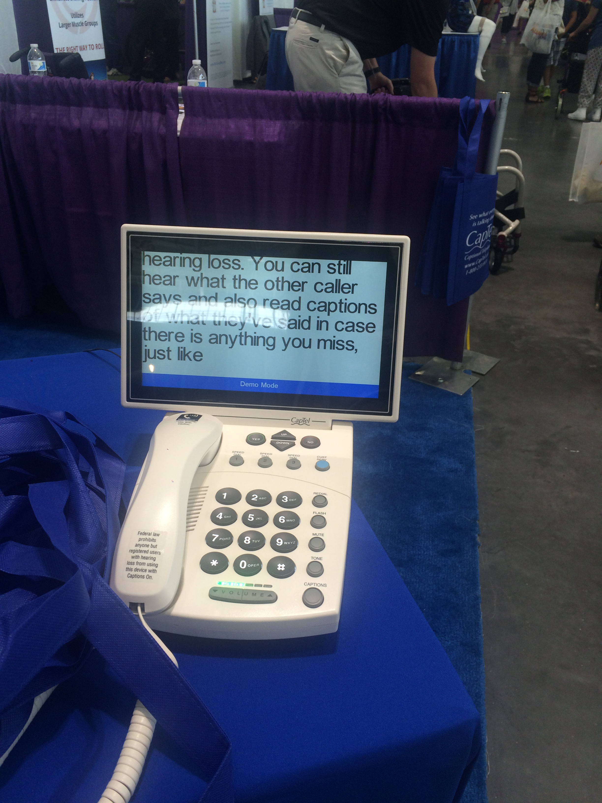
CapTel Captioned Telephone
This is a phone that connects with a free captioning service. This phone allows you to hear the other party while also being able to read what they are saying through the transcription of what they are saying.
Notes:
I think that this device would be very helpful for people who are slightly hard of hearing or have more trouble processing words that they hear. I am not sure what other situations this phone could be used for. It would be interesting to see and hear about the different people that have used it.

Slide 7
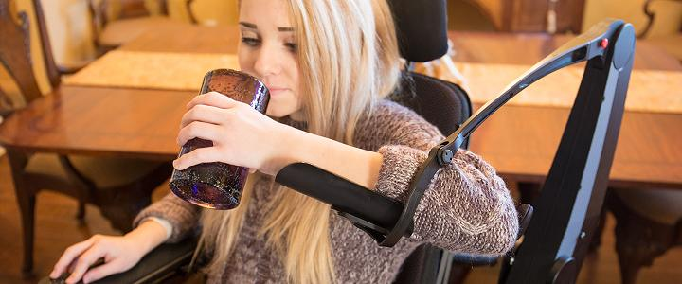
GoWing Dynamic Arm Support
This product mounts onto any power wheelchair and provides assistive support for your arm to let you easily reach objects beyond your grasp. It helps counteract gravity which allows you to raise and lower your arm without physical effort.

Slide 8
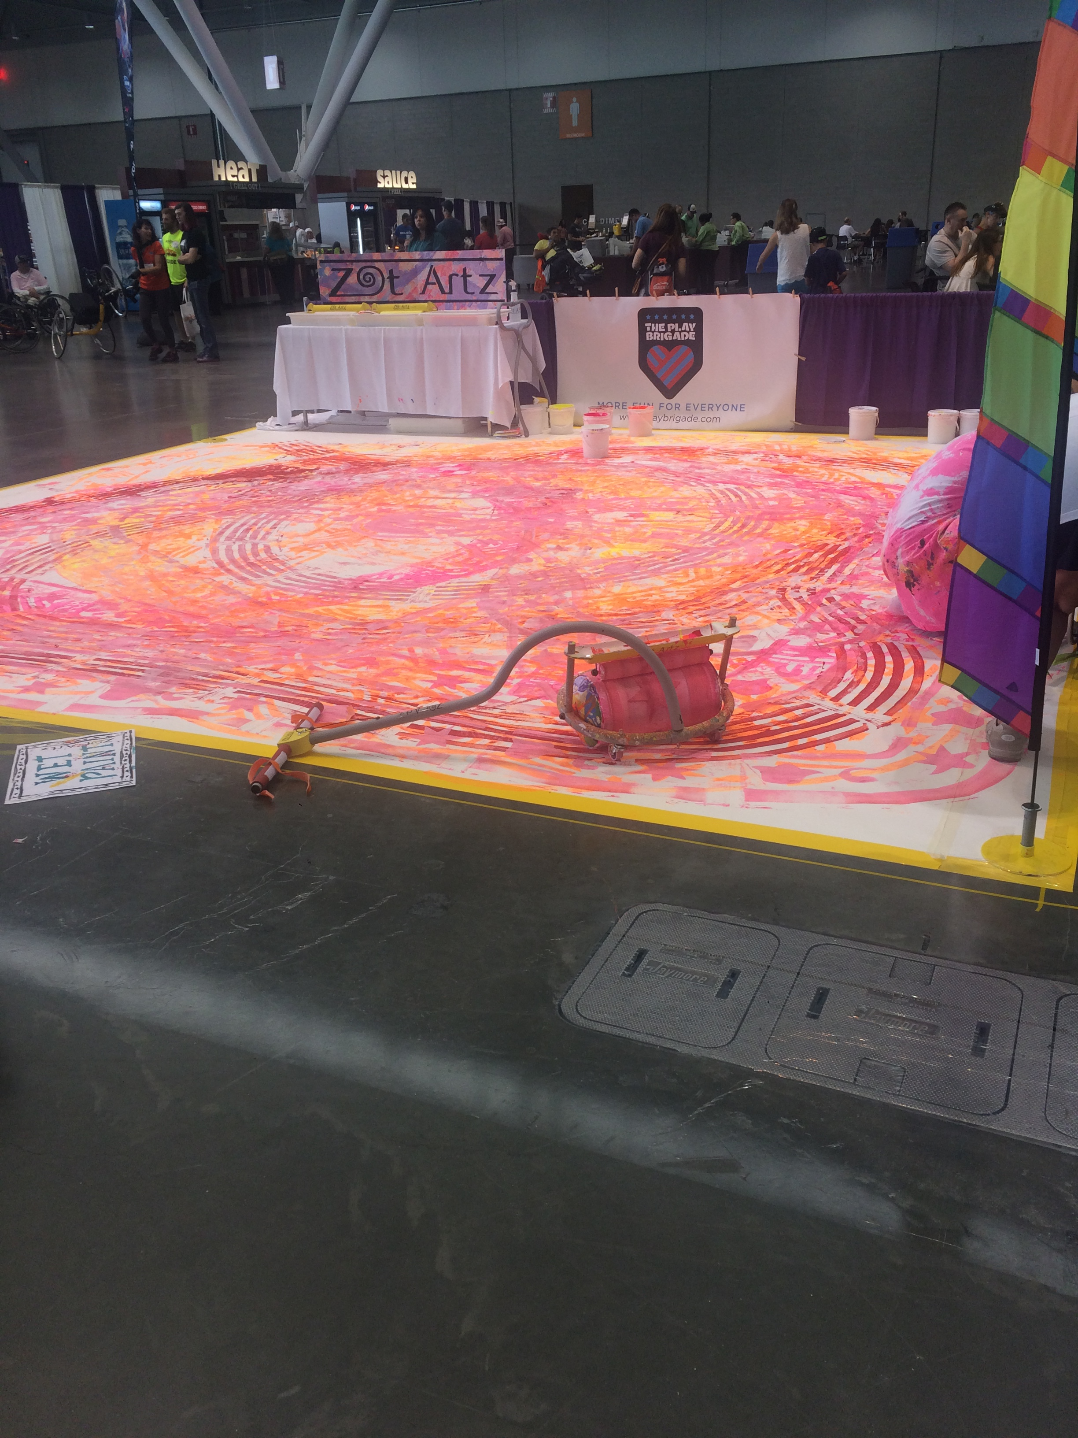
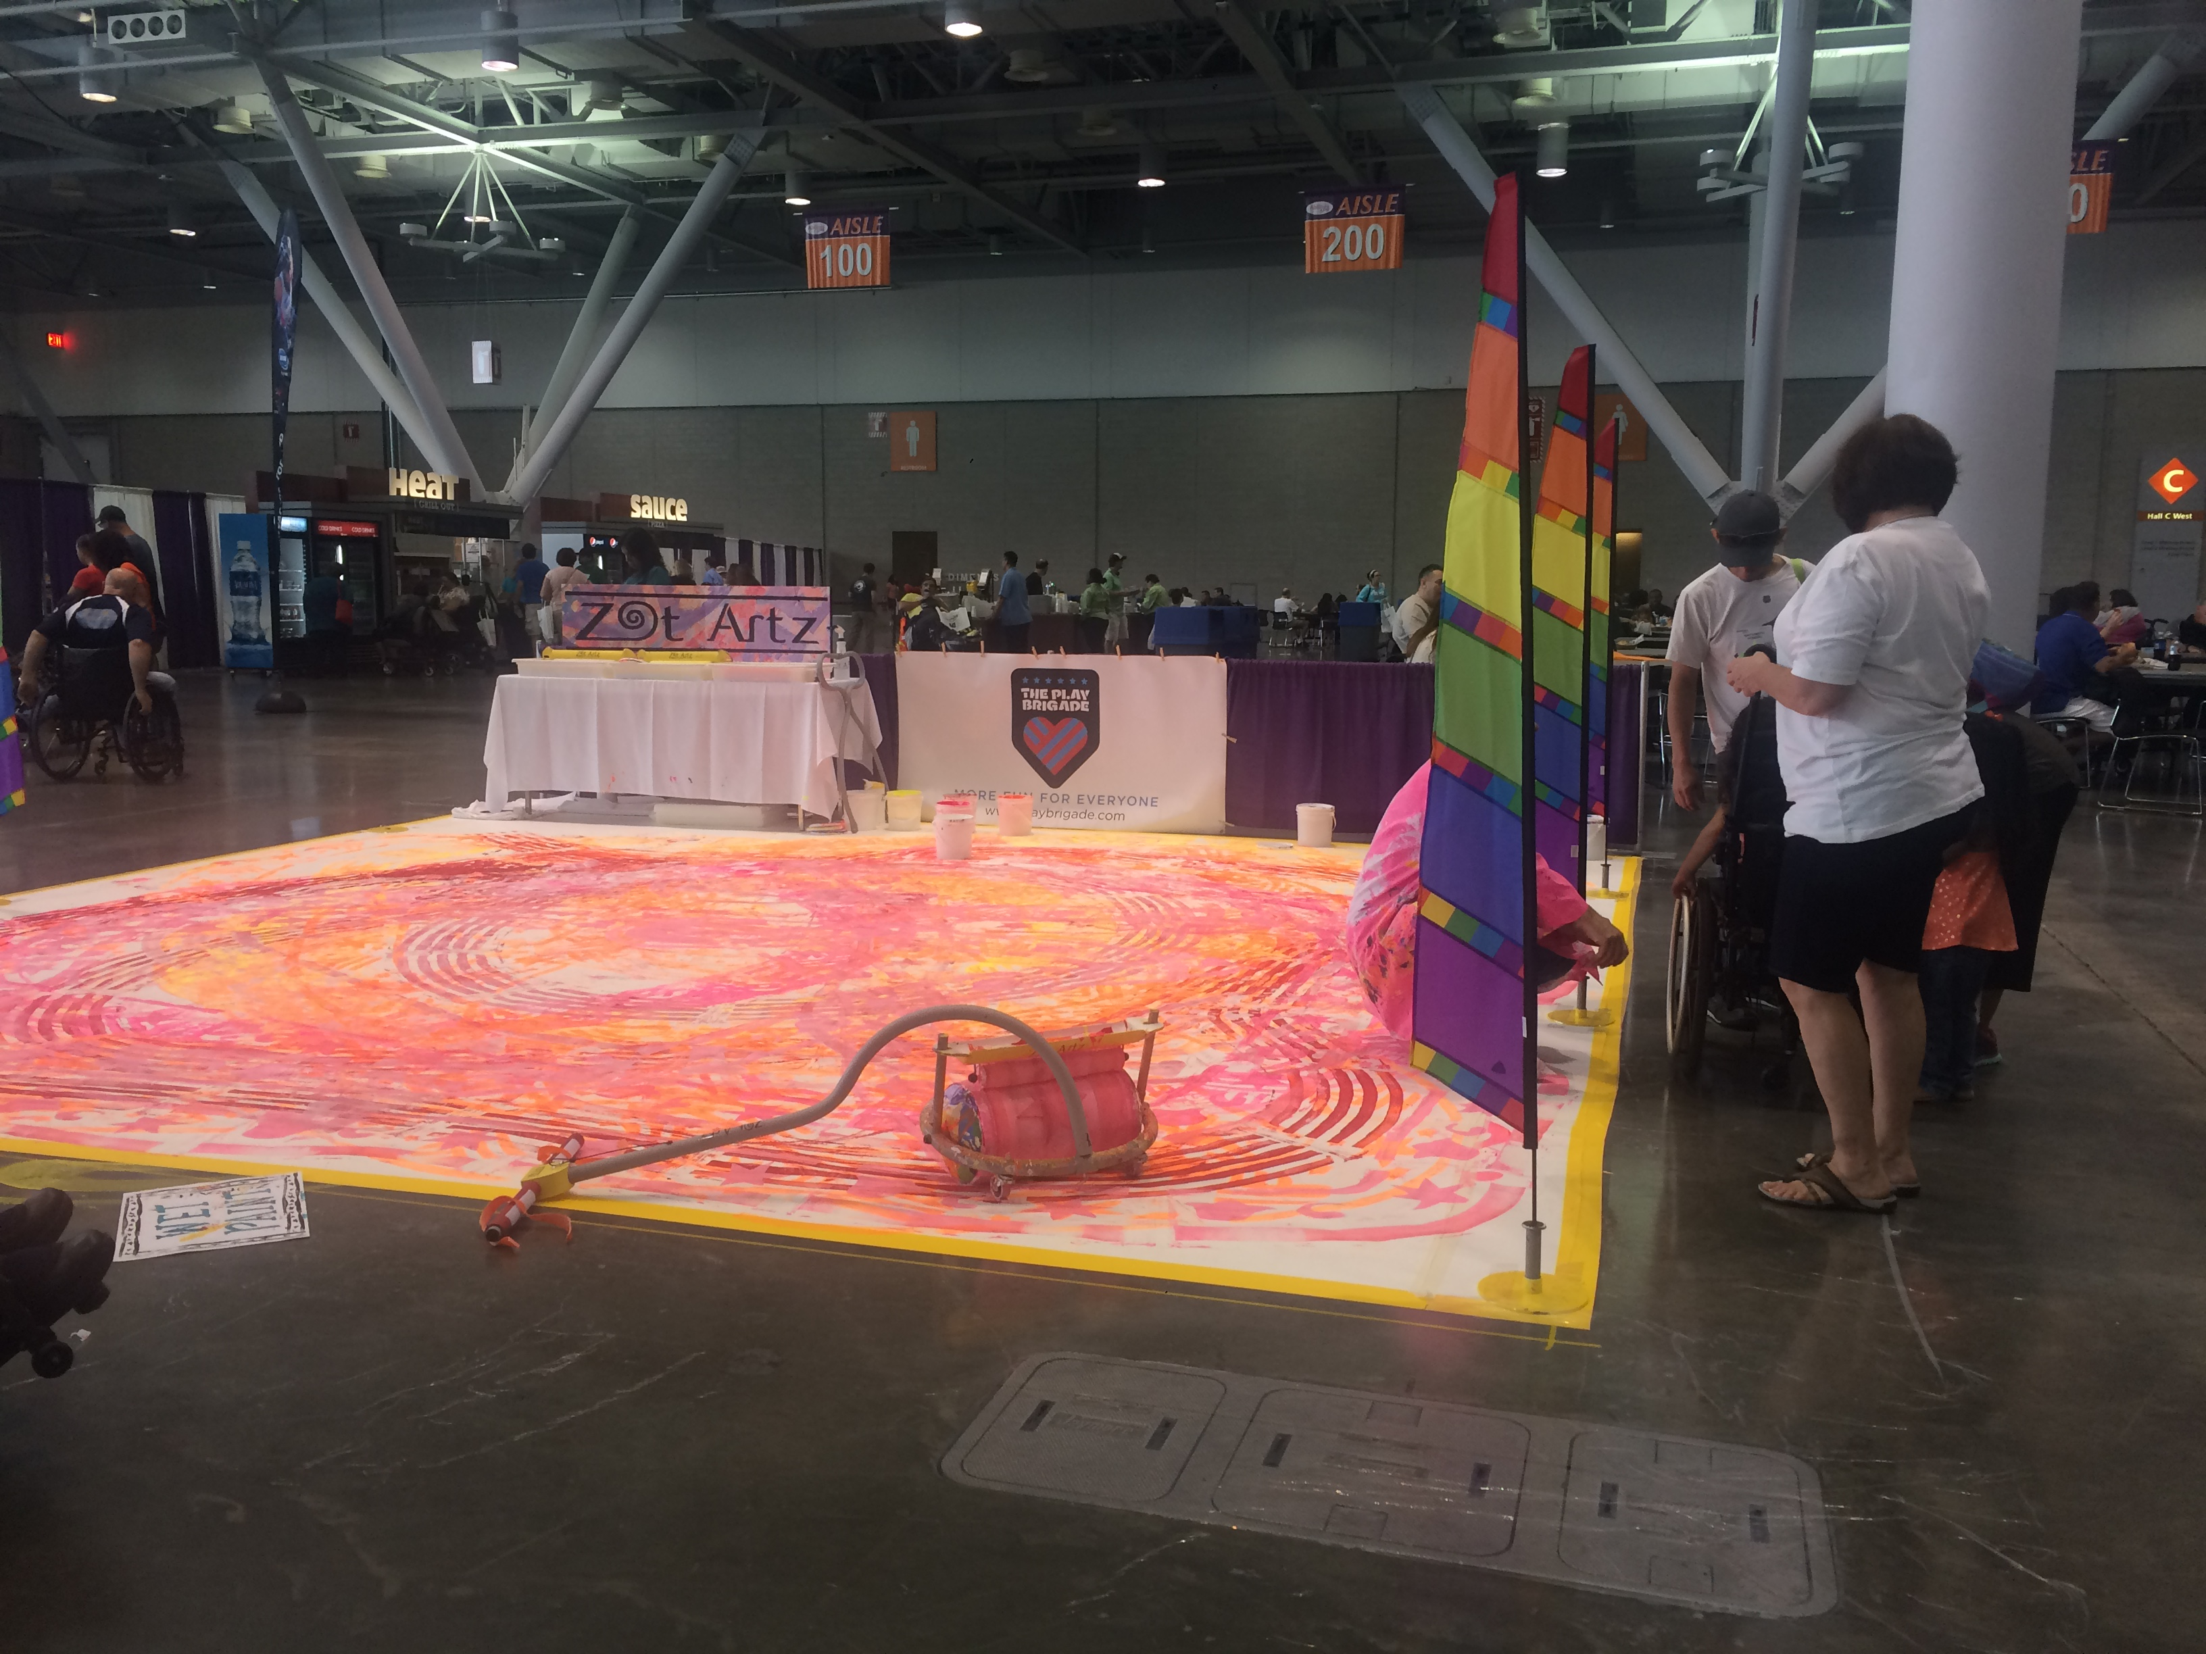
Zot Artz adaptive art tools for children with disabilities
This is an adaptive art activity presented by Zot Artz. This company designs and makes adaptive art tools so that children with disabilities can create huge, amazing art pieces.
Notes:
This is one of those products that is not related to everyday needed use, however it is and looks very fun. It is a way for people to be expressive and take part in art which is important for people to be able to do. This product can be pushed physically or pulled by a wheelchair. People seemed to be having a lot of fun trying this product out and it was nice to see a cool piece or artwork afterwards.

Slide 9
Power Soccer Demonstration
This was a demonstration given in the events area of people who were wheelchair bound playing a game of soccer.
(click play button to watch video)
Notes:
I really enjoyed this demonstration and this technology because I personally can relate to the love of soccer. I have played soccer throughout my life and find it to be such a fun sport. This was enjoyable to watch because I never thought someone who is wheelchair bound could participate in a soccer game. I wonder if this is or could become a part of the Special Olympics.

Slide 10
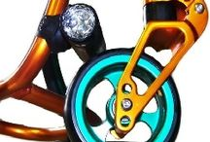
Frog Legs, Inc.
This company manufactures precision-built suspension products. This is applied to wheelchairs in order to protect riders from effects of rolling over rough terrain. It also alleviates the rider of the constant pounding that can cause pain and fatigue.
Notes:
I think that this is a great invention. There are many rough, uneven surfaces that people in wheelchairs travel on, on a daily basis. I think these are great because they actually help riders to have less pain and fatigue. I compare this to riding a horse, or traveling on a boat through choppy waters. After these types of experiences you become very fatigued and your muscles are sore and tired. This is the same principle and I’m sure it is very helpful for wheelchair users.

Slide 11
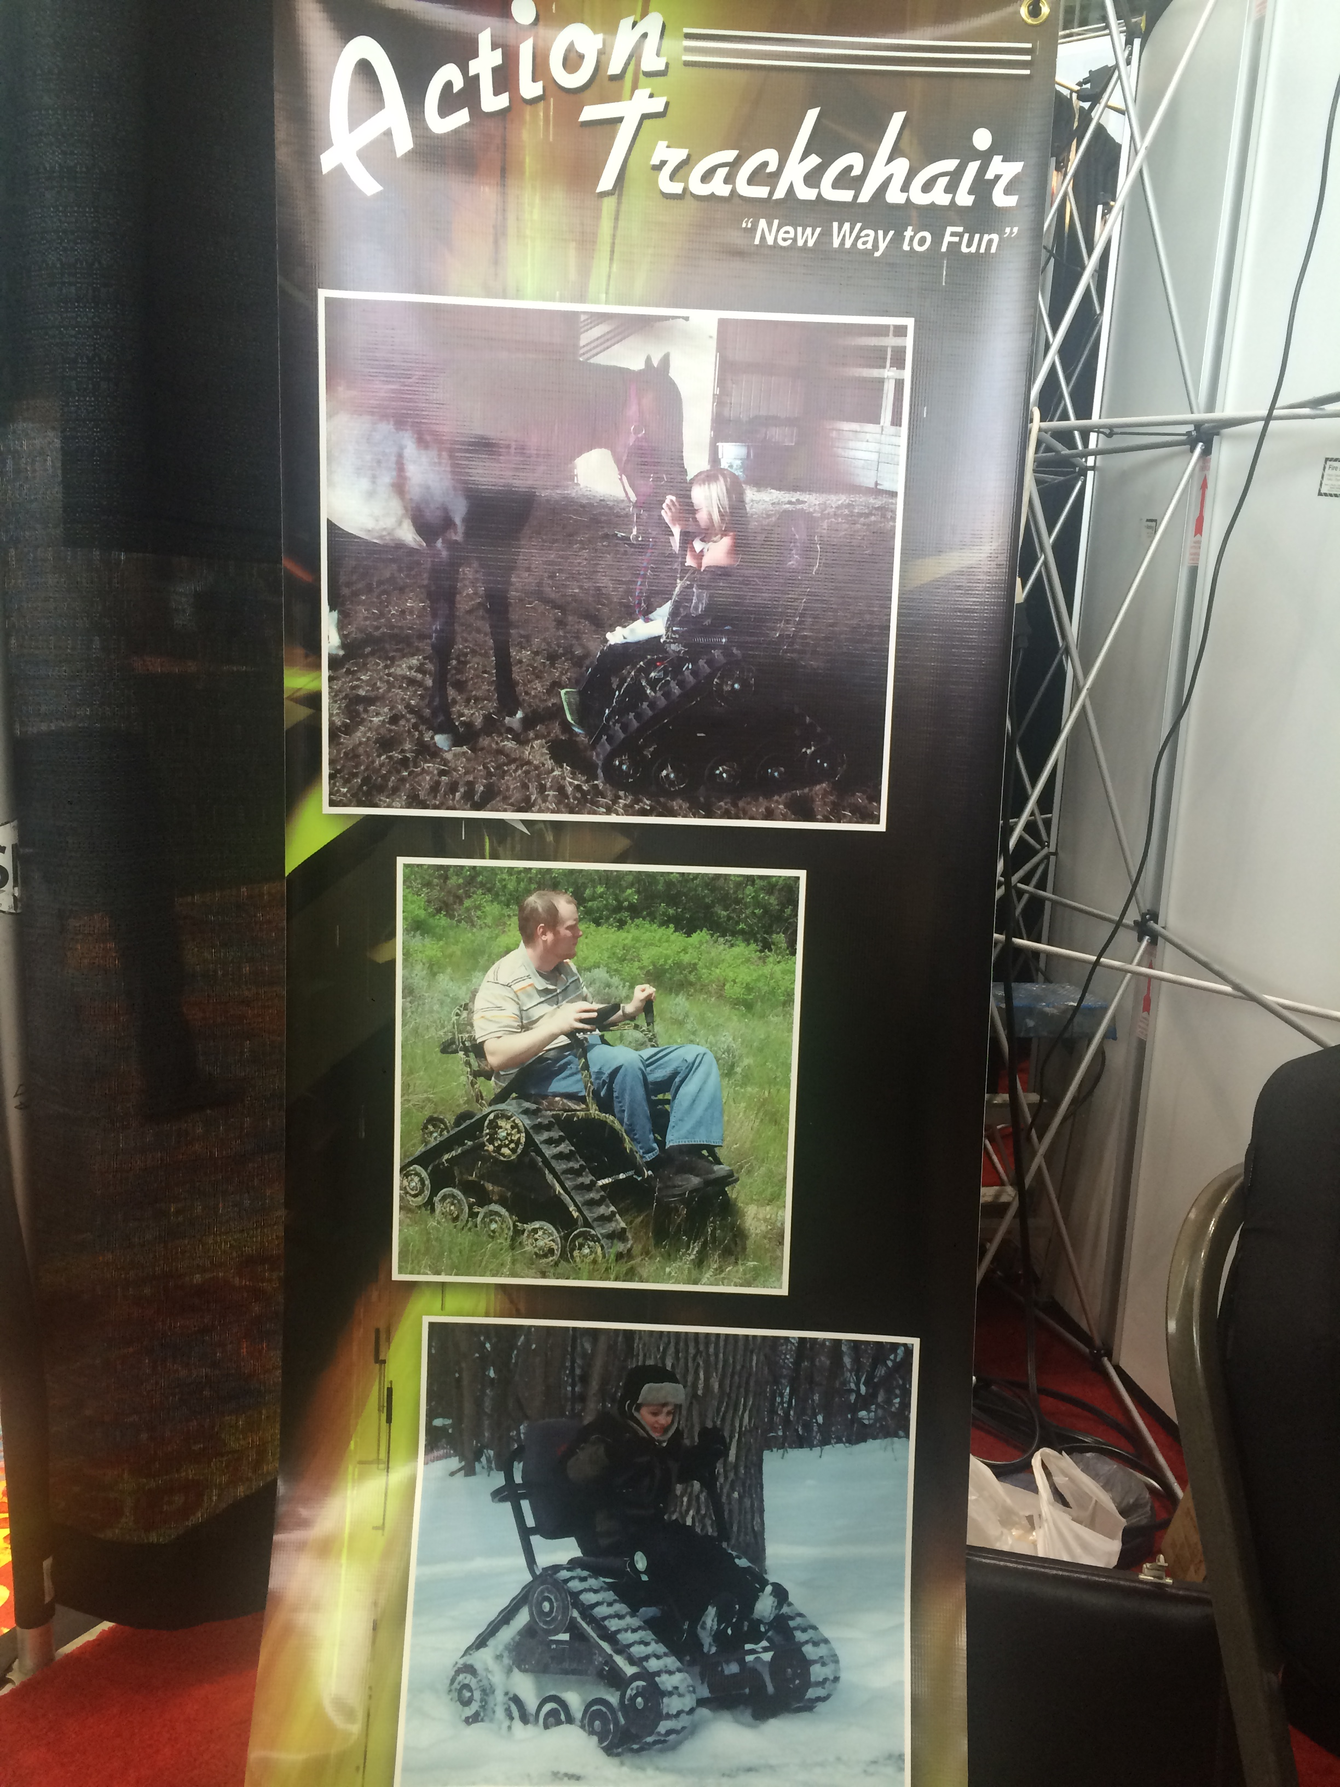
Action Trackchair
This wheelchair allows you to experience more adventure by providing traction for your wheelchair. This means that the wheelchair can go through different terrains such as snow, mud, rocks, etc. This product also allows you to stand up rather than just sit!
Click here for a short video on how it works
Notes:
I really like this product because it allows people to be able to go anywhere they want. Their wheelchair is not so much of a restriction with this product. I also think it is great that it allows people to stand in a sense.

Slide 12
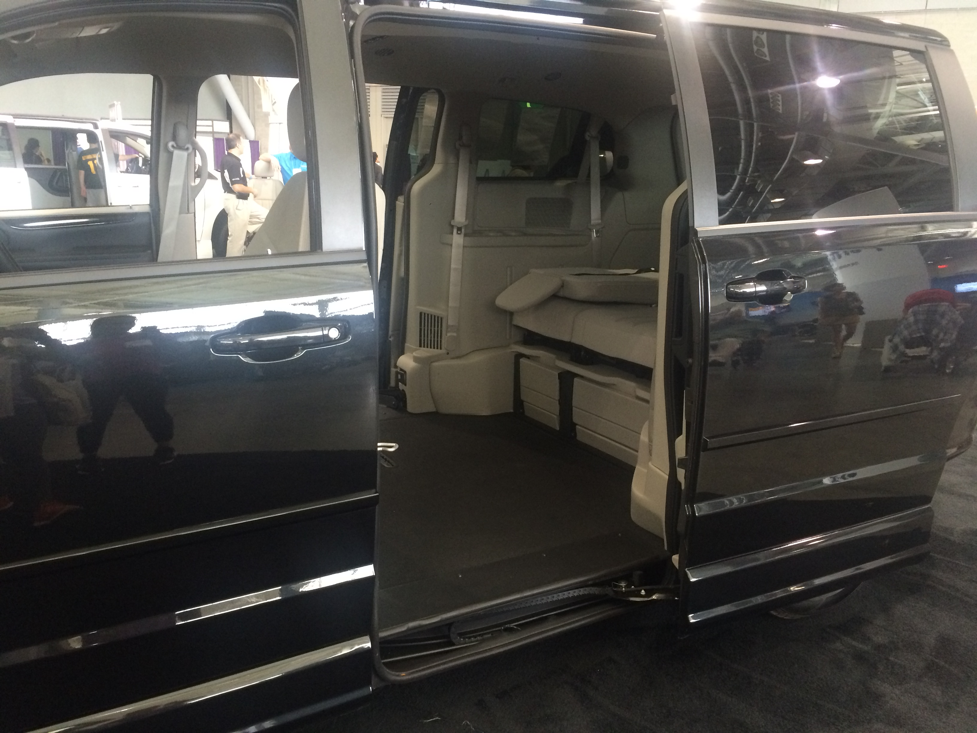
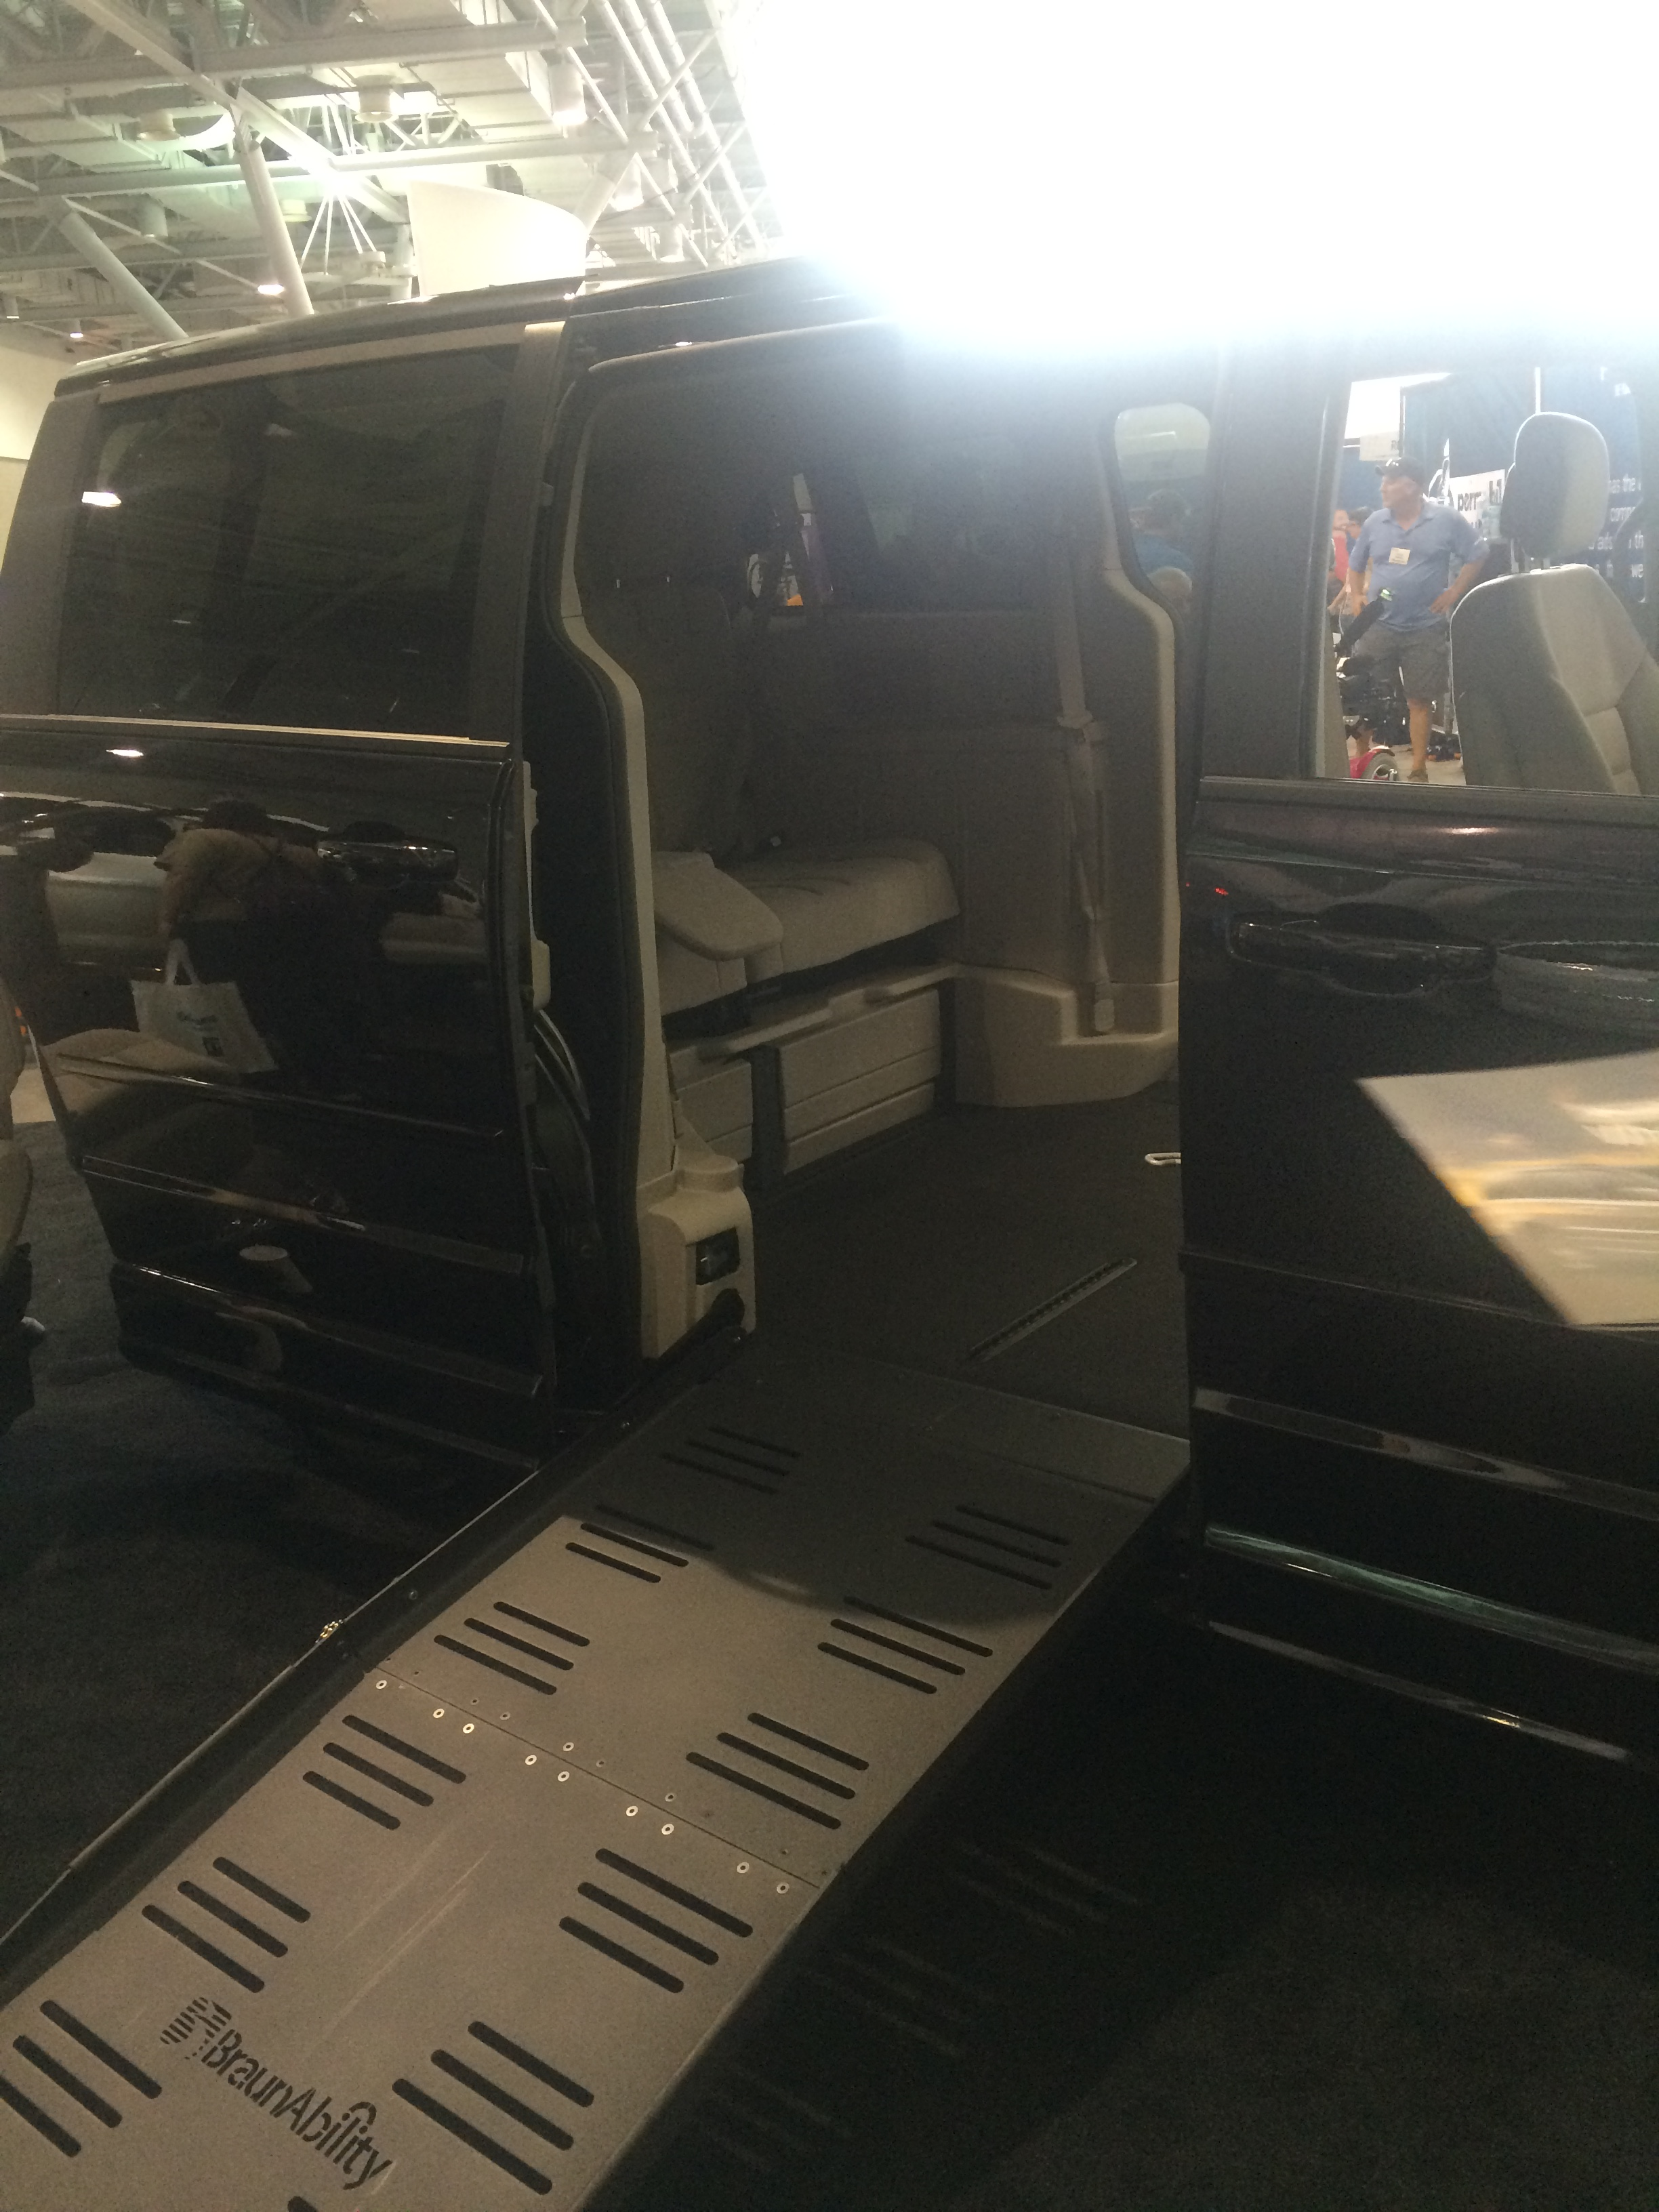
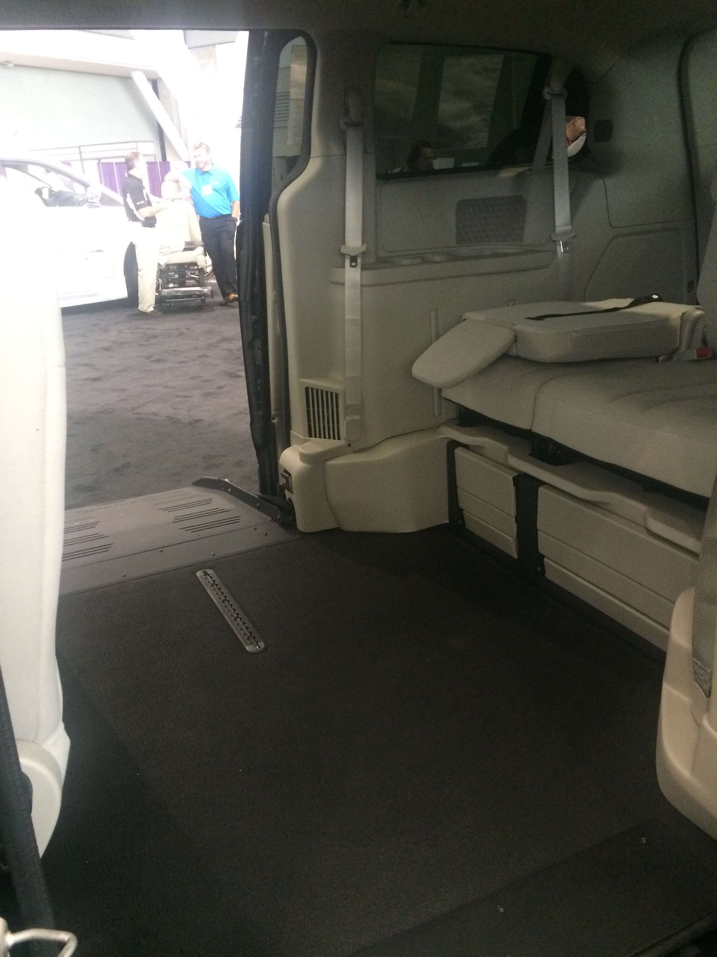
BraunAbility
This company specializes in wheelchair accessible vehicles. They work with Chrysler, Dodge, Toyota, and Honda. They specialize in wheelchair Vans, Wheelchair Lifts, Commercial Vehicles, Mobility Taxis, and Mobility Crossover Vehicles.
Notes:
I liked this product because we could actually climb into the car at the expo and explore what each one had to offer. It was interesting to see how the different cars had different functions. I liked how each car was able to be arranged in a number of different ways so that a wheelchair could fit along with passengers in multiple ways.

Slide 13
Enovative Technologies
This is a specialty retail organization that focuses on providing unique products to targeted markets. Their products are designed to help improve people’s lives. These products mainly consist of different message products. These also provide TENS and EMS therapy to help with back pains, headaches, shoulder and neck pain, sore hips, knee and ankle pain, Sciatica, Fibromyalgia, Plantar Fasciitis, Arthritis, Tennis Elbow and most common blood circulation problems
Notes:
I think this is a helpful company because it is a way of accessing technology that can help so many people with different types of pains. Having these different types of aches and pains can be distracting when trying to get work done. I think it would even be beneficial to certain students in classrooms to be able to receive these different types of massages or therapies.

Slide 14
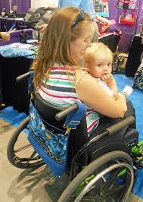
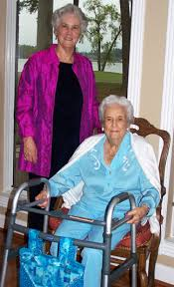
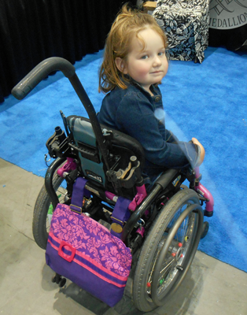
HDS Medallion
This company specializes in making different CarryAll bags made for mobility devices. These bags connect to different mobility aids such as: walkers, power chairs, medical scooters, wheelchairs, and cain and personal shopping carts.
Notes:
Although this is not complete technology, I would still consider it to be a technology that people can use everyday. I relate this to when I was on crutches and how difficult it was to carry my books at school to and from class. I would have loved to have had something like this to aid me in getting around while also carrying the things that I need to bring with me.

Slide 15
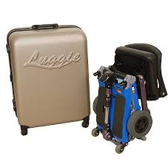
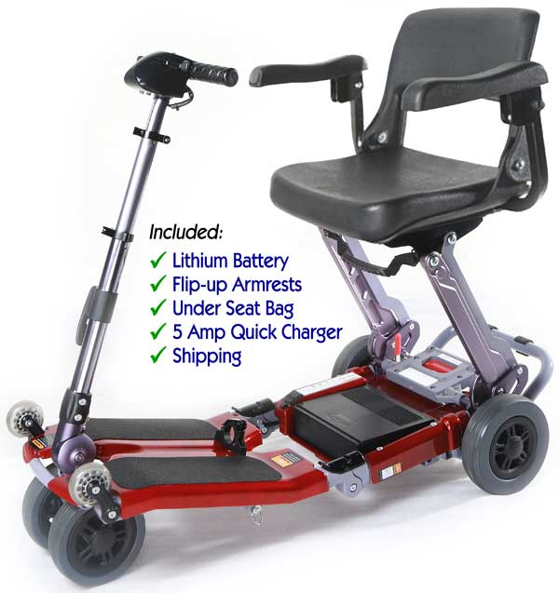
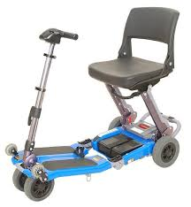
Luggie Scooter Inc.
This scooter is innovatively designed to be able to fold and unfold quickly with a minimum of fuss or bother. It is also smaller so it can easily fit into cars without any sort of expensive lift. It can go up to 11 miles before needing to be recharged.
Notes:
This is one of those products that I never really thought about until I saw it. This product seemed helpful simply because it is not a huge piece of equipment. It seems like it would be helpful for navigating around different places and does well outdoors. I think the idea that it is able to fold up and fit in many places is great. This also thinks it might be great for people who want to travel far on different vehicles such as boats or air planes.

Slide 16
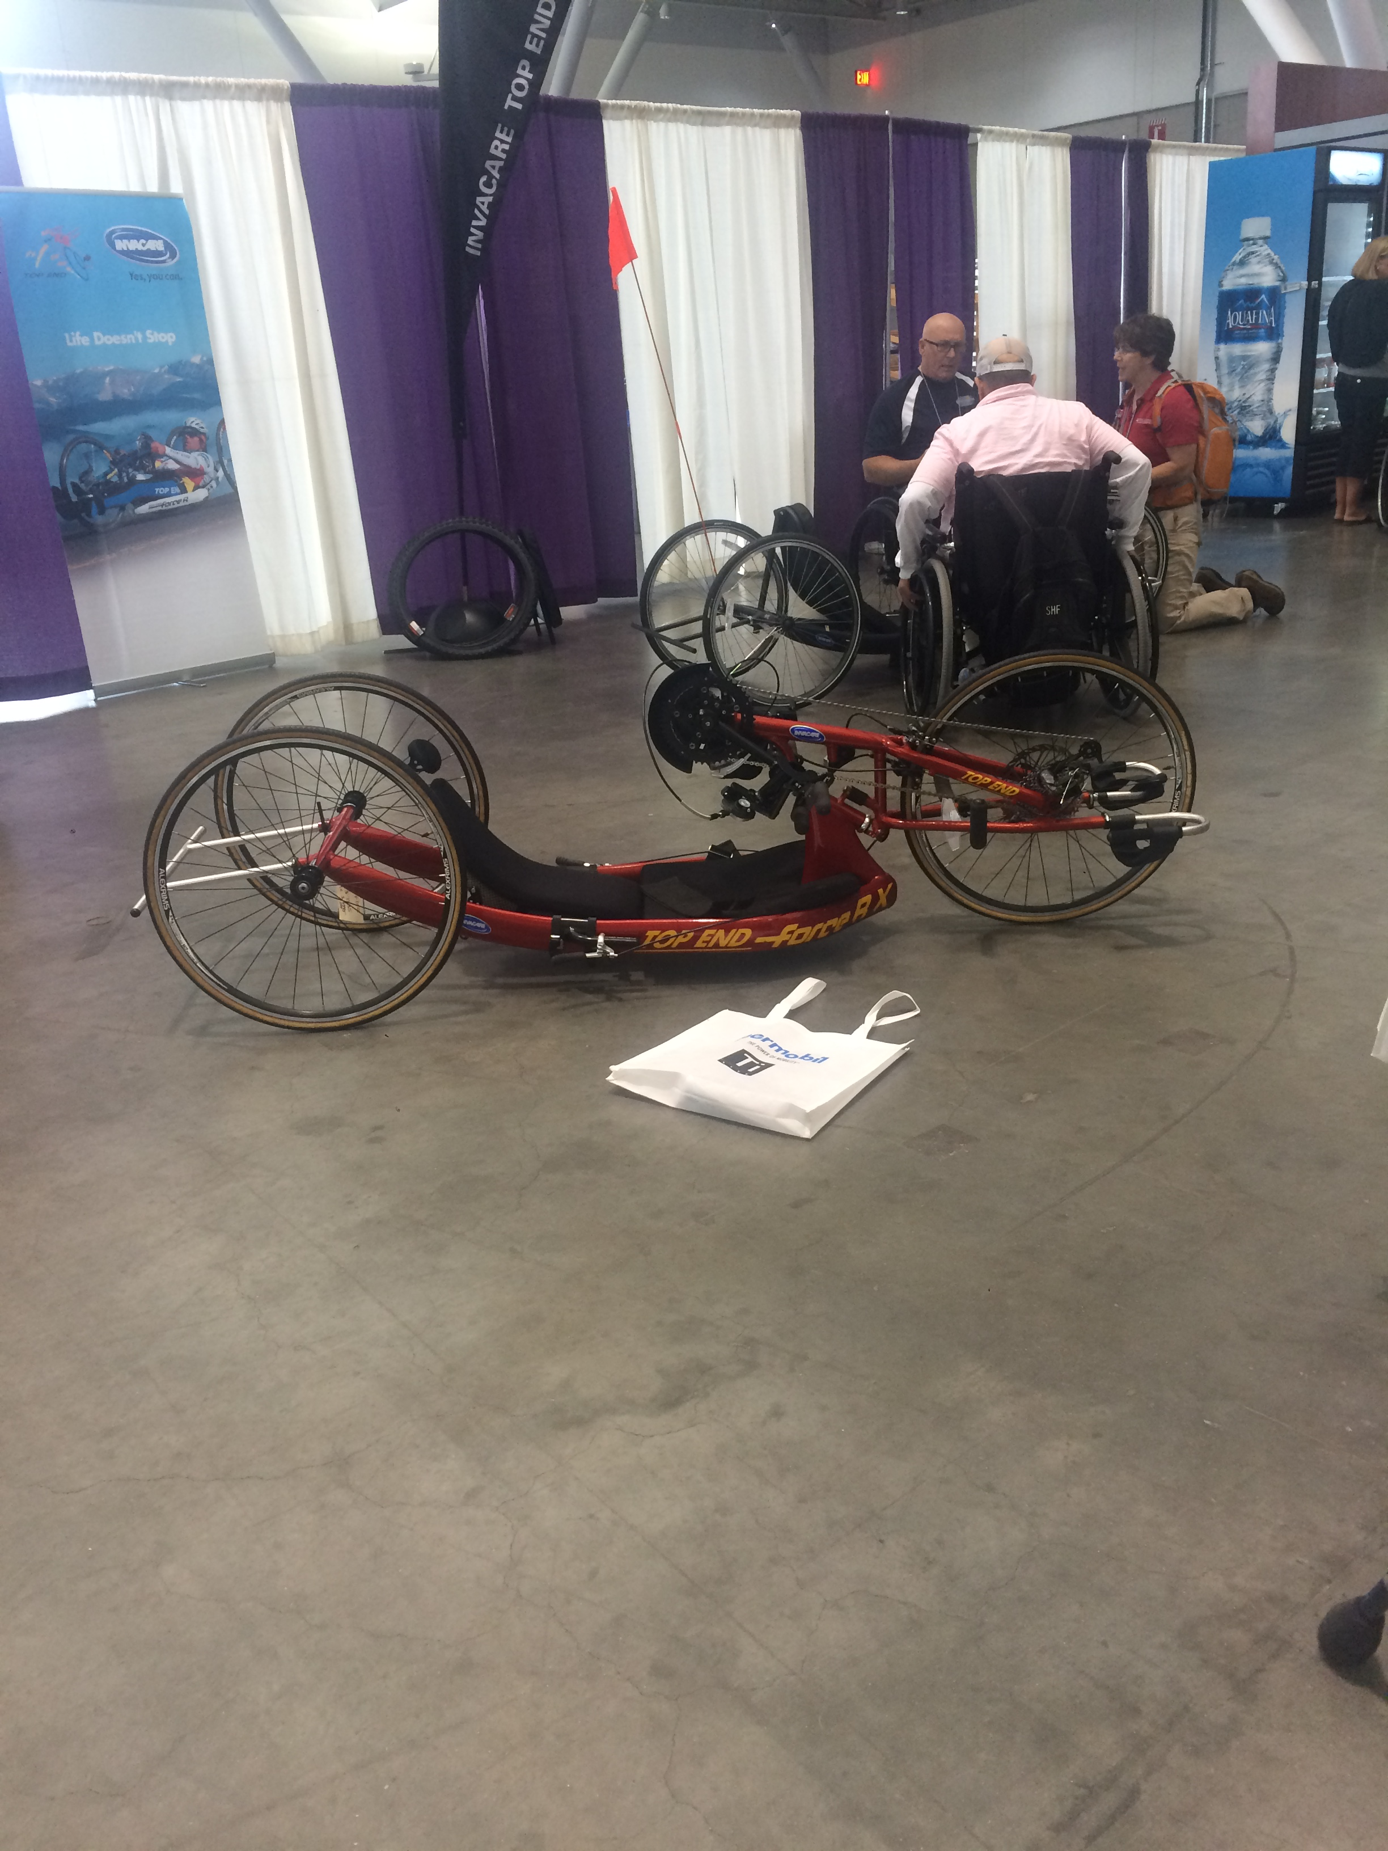
Invacare Topend Hand Cycling
This company specializes in sports bicycles for individuals who may be wheelchair bound or need specialized bicycles. They have different sports products for racing, basketball, tennis or handcycling.
Notes:
This product is great because it deals with mobility as well as competitive sports. I enjoyed looking at this up close at the expo and thought it was really interesting because of how its built and its shape as well as its different functions.

Slide 17
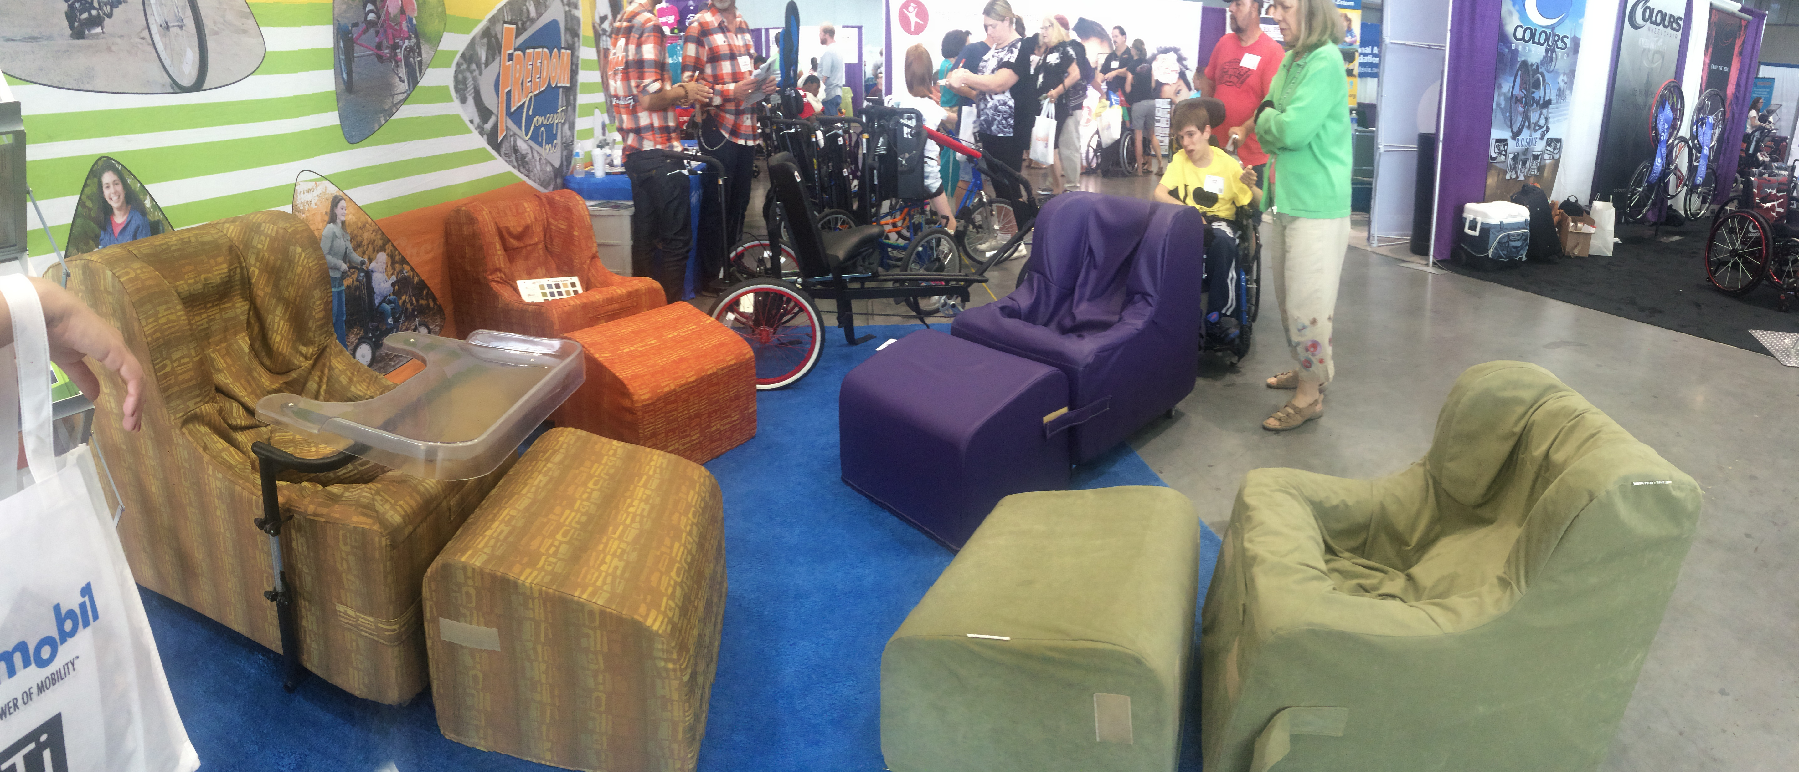
Chill-Out Rocker Roller Alternative Seating
This company makes a number of different chair and products that allow minimal movement but without the need of restraints. They come in a number of styles including accessories such as upholstered tray inserts and feedin/activity trays. This product benefits people that have disorders such as Aspergers, Autism, Cerebral Palsy, Downs Syndrome, Fetal Alcohol Spectrum Disorder, Rett Syndrome, Angelman Syndrome, Traumatic Brain Injuries, Spinal Deformaties, and many others.
Notes:
I think this is a great company with awesome products. These products I would love to have for the classroom I am in now. The classroom specializes for children with autism spectrum disorders and I think that the children would benefit from these chairs in so many ways. Many times they have trouble paying attention or getting work done because they are uncomfortable in the seats they sit in, so these could provide a helpful solution to that problem.

Slide 18
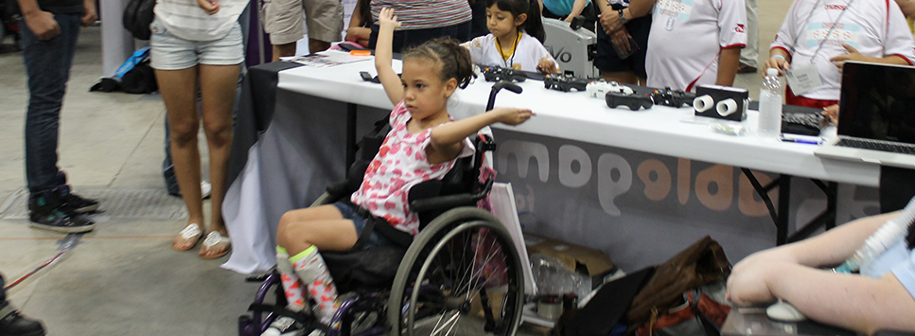
AbleGamers Foundation
This company serves over 70 million members of the disabled community. What they do is advocate for greater access to video games. These games also allow disabled individuals to be able to experience situations that may be difficult or limited in the real world, provide social networking opportunities to maintain mental and emotional health, and participate in one of the world’s largest pastimes.
Notes:
I think this is a great foundation with multiple different types of technologies. I love how games do not have to just be fun video games, but can also be helpful in simulating real-life expiriences that certain individuals with disabilities might not be able to experience normally.

Slide 19
The Bridge Center
This is a company that specializes in affordable, year-round therapeutic recreation and equine-assisted therapy programs for individuals with disabilities. The programs that they offer are designed to meet the social, emotional, and physical goals of participants, regardless of the nature and severity of their disabilities .
Notes:
I think this is a great resource for people with disabilities. They have many different technologies that they use for disabled persons in order to take part in typical camp activities such as horseback riding, playing on playgrounds, and performing arts and music.

Slide 20
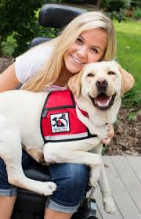
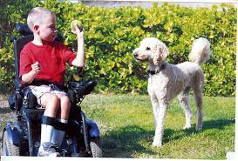
Canines for Disabled Kids
This organization specializes in educating all different types of folks about service dogs and the unspoken rules about service dogs. They also provide service dogs to many people with disabilities. These service dogs can help with psychiatric disabilities, guiding, hearing, seizure alert, social services, therapy, traditional/mobility services, and walker balance.
Notes:
I think that dogs can be a great form of assistive technology for people with disabilities. I was not even aware of all of the different services that these dogs can provide to all sorts of people. I think that this is a great company and I also like how they educate and inform others of how these dogs work, because that is also important for people to understand.

Slide 21
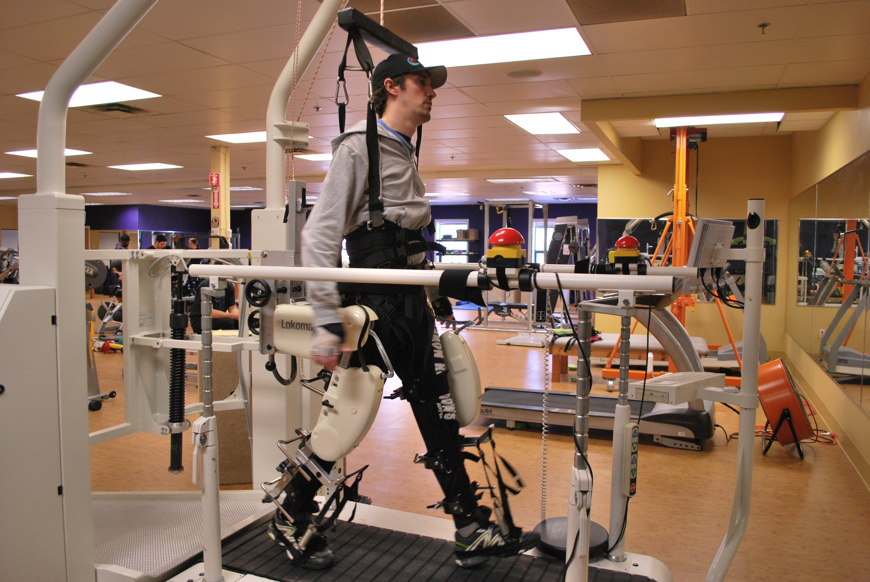
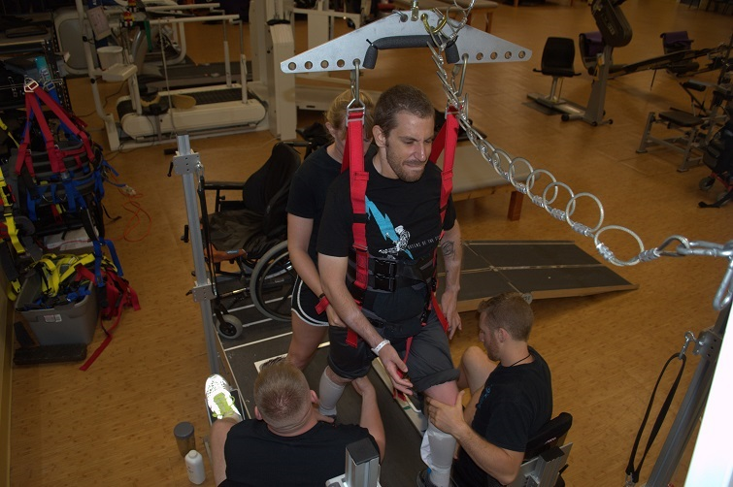
Journey Forward
This is an exercise based program designed to assist those with Spinal Cord Injuries so they too can achieve some of these most basic lifelong functions and benefits. They have many different types of accessible equipment for people who need help with therapy.
Notes:
I thought that these technologies were really cool for helping people recover from spinal cord injuries. They had a video playing at the expo of all the different machines that they used with people and it was one of the most interesting things that I was able to look at. I enjoyed searching their website afterwards as well and seeing all of the different programs they have and more equipment that they use!

