Slide 1
Abilities Expo 2015 Assistive Technology By: Sarah Mitri
“The Abilities Expo AT Showcase is your chance to explore how assistive technology can help you or your loved ones bridge the gap between ability and disability!”
Notes:
The Abilities Expo: Boston 2015 was held September 18th-20th at the Boston Convention Center. Of these set days I was able to attend on Sunday September 20th. Here I was exposed to a number of different platforms of assistive technology.

Slide 2
INTERACTION. JOY. KNOWLEDGE.
Notes:
At this event I got to talk with numerous different people about their products and the impacts the have for the people they serve. Also, I was able to see many disabled people here partaking in the events and see the happiness on their faces and hear their laughter only further proving how rewarding all aspects of this line of work is. I also gained a large amount of new information that I will be able to take with me through this experience.

Slide 3
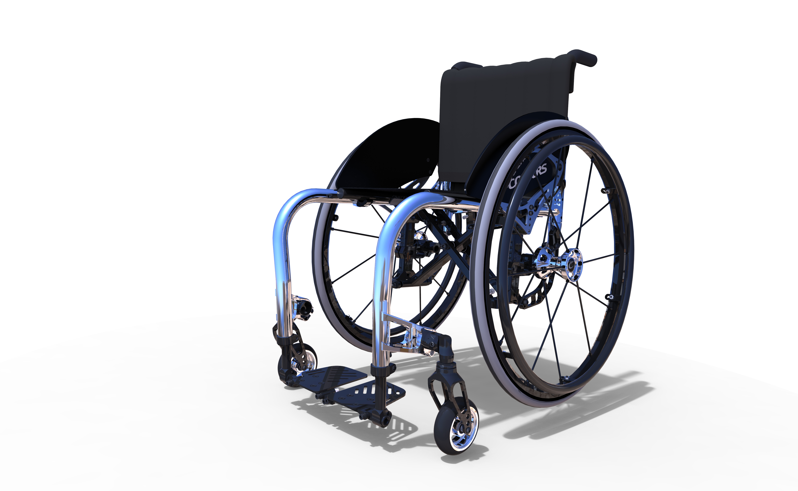
Colorus Wheelchair: “Not just Another Wheelchair Company… It’s a Lifestyle!”
Founded in 1992
“Main goal was to improve the disabled peoples life though innovation in equipment and services to the disabled community”
Lightweight and easy to maneuver ~14-16lbs.
Notes:
While were browsed at many of the first initial booths, this was one of the first we stopped at. Immediately we were engaged by a man in a wheelchair who happily invited us to try one out. I was hesitant at first but with minor encouragement from him, I did. I had never sat in a wheelchair before and share this information with him. I was surprised at not only how comfortable it was but also by how easy and fun it was to use! He went on to tell us they make chairs for people of all ages and are great for outdoor use as well because they are very shock resistant!

Slide 4
Permobil: “The Power of Mobility”
“Founder stated over 40 years ago: "Every disabled person has the right to have his or her handicap compensated as far as possible by aids with the same technical standard as those we all use in our everyday lives.””
“To stand up for the consumers' rights and provide the best possible solutions is our strategy... past, present and future.”
Notes:
After seeing the first exhibit of wheelchairs I was intrigued and curious to know more. I walked over to this booth and began to look around at what they had on display. I picked up a pamphlet to wait while a handicapped man and his two children were talking with the attendant here. I realized he was ordering a chair and I didn’t want to interrupt since no one else appeared to be around I followed up with it online instead. It is a widely known and respected company that helps numerous individuals physically and allows them freedoms outside their disabilities. I was very impressed with this technology!

Slide 5
IN Visible Project: Real People/ Real Photos REAL HOPE
“The INvisible Project highlights the day-to-day experiences of pain survivors through photographs. These photographs capture the struggles and triumphs of these brave pain survivors. As the INvisible Project allows the outside world a glimpse of what it is like to live with pain while persistently pursuing to live a meaningful life, the goal of this project is to create pain awareness, empower survivors and generate change.”
Notes:
This organization is a fantastic idea that helps to promote awareness for individuals who suffer in silence. This helps to advocate for these people and in knowing they are not struggling alone. Those suffering or who have suffered are brave and deserve the recognition for their triumphs!

Slide 6
Reach 4 Real: “A music and theater program for people with developmental, physical, and intellectual disabilities”
“Enhancing the lives of people with needs through music enrichment”
https://www.youtube.com/watch?v=5G35nKyB340
Notes:
I have studied recently in another class the power of music in the face of adversities in terms of resiliency. This project is something that really stood out too me and made me smile knowing what a satisfying and happy experience this program is for some. While I was at this booth a women in a wheelchair was watching this video in the link above and when it finished she said, “oh yeah, that’s definitely something I would like to do.” Music is a positive and healing experience.

Slide 7
The Coalition Against Pediatric Pain: “Because no child should live in pain”
“The Coalition Against Pediatric Pain is a national non-profit committed to improving the quality of life of children living with chronic pain from rare diseases by: supporting and uniting families affected by pediatric pain, advocating for children in pain by increasing awareness of their needs, educating others regarding their long-term consequences of pediatric pain, funding research dedicated to pediatric pain conditions and providing resources to families and professionals.”
Notes:
It is heartbreaking to think of a child in pain. This organization is fighting for these individuals and their families and it is so greatly important for them and that they continue to do so. I am glad someone is a fighting force behind these helpless and innocent individuals.

Slide 8
Zot Art: “Arts for All”
“Inclusive activities designed for people with disabilities”
“Rather than finding ways for people with disabilities to participate in activities for non-disabled people, we create entirely new activities and projects for people with disabilities and invite those without disabilities to join in.”
Notes:
As I mentioned with music being therapeutic, all forms of art and expression are. This is a fun and engaging activity for people of all ages. Something that I really liked was that this was not something that had to be adapted for certain individuals, it was designed already adapted for them. I was invited to take a turn in painting and it was a lot of fun! I also got to watch a few people with disabilities try it out as well and it was great to see their reactions—they loved it!

Slide 9
Northeast Passage: “Living Beyond Disability”
“The mission of Northeast Passage is to create an environment where individuals with disabilities can enjoy recreation with the same freedom of choice, quality of life, and independence as their non-disabled peers.”
“We do this by developing, delivering, and evaluating innovative barrier-free recreation and health promotion programs.”
Notes:
I really loved this organization. It is so easy to take some of the things we as non-disabled people can do for granted but here in their “barrier free” environment everyone can thrive and enjoy themselves alongside peers as well. This program must be so fulfilling for so many people.

Slide 10
Empower Spinal Cord Injury: “A Second Chance At Rehabilitation”
“Empower SCI is a non-profit corporation established to enable individuals with spinal cord injuries to lead happier, more meaningful and more independent lives. Empower SCI seeks to fill the gap in the rehabilitation industry that has been created by a decrease in length of stays at rehabilitation hospitals and outpatient services during the recovery from a spinal cord injury.”
“Residential Rehabilitation with focus on peer mentoring, recreation, and social support”
Notes:
This service is a wonderful opportunity for individuals suffering with spinal cord injuries to be able to recover and heal in the best way possible when other resources are lacking to meet their full needs. This offers patients the critical time they need to recover to help them live their lives to the fullest.

Slide 11
U.S. Pain Foudation: “Empowering Us All to Live Fulfilling Lives”
“Chronic pain affects nearly 100 million Americans.*
Pain costs the nation up to $635 billion each year in medical treatments, disability payments and lost productivity.*
Despite the vast number of people living with pain, many in the pain community feel unheard and isolated.
Chronic pain is still widely underfunded, misunderstood and undertreated. “ *Institute of Medicine of The National Academics
“To connect, inform, educate and empower those living with pain while advocating on behalf of the entire pain community”
“U.S. Pain Foundation is a 501 (c)3 non-profit organization dedicated to serving those who live with pain conditions and their care providers. Founded in 2006 by a fellow person with pain, it is the mission of the organization to connect, inform, empower and advocate for the pain community. U.S. Pain is here to help those who live with pain and their care providers find resources and inspiration.”
Notes:
It is very disheartening to know that people live with such physical pain. This organization seeks to help these individuals in many different ways. Not only is this non-profit group advocating for this entire community, they are helping these individuals to learn more and be able to find the help they need.

Slide 12
Ms. Wheelchair Massachusetts
“Ms. Wheelchair Massachusetts educates and advocates for individuals with physical disabilities in order to influence social change for all Massachusetts residents.”
“Ms. Wheelchair Massachusetts seeks to give women with physical disabilities in the Commonwealth a forum for the promotion of the achievements as well as the needs of mobility impaired persons. “
“Dedicated to increasing public awareness so that all its citizens will be able to lead productive and meaningful lives.”
Notes:
This pageant is a wonderful idea. Ms. Wheelchair Massachusetts is a nontraditional platform to let an individual shine. It also is a great way to be active in promoting and fighting for changes that need to be made.

Slide 13
Hawaiian Moon Aloe: “Say goodbye to dry skin”
“Dramatic improvements in dry skin, abrasions, acne, allergic, rash, arthritis, athlete’s foot, bed sores, bee stings, blisters boils, bruises, burns, bursitis, candida, canker sores, chapped lips, chapped skin, chemical burns, chemical peel, cold sores, cradle cap, cuts, dermabrasion, diaper rash, eczema, edema, fever blisters, flea bites, follicularis, fungus, hives, impetigo, inflamed joints, insect bites, itching skin, jock itch, keratosis, lupus, poison ivy, poor circulation, psoriasis, radiation burns, ringworm, rosacea, sebaceous cyst, scabies, seborrhea, shingles, sore muscles, stretch marks, styes, sunburn, varicose veins, very dry skin, warts, wind burn, x-ray burns, and much much more !!”
Notes:
I was able to have the opportunity to stop at this booth and learn about this great product as well as test it out. This cream is very helpful to people struggling with any number of the things listed above and can aid in releasing some of the pain that some conditions may cause. For me I saw how quickly it moisturized my dry skin that day and believe the effects could be tremendous for others. The woman we spoke with showed us a spot of eczema on her hand she was currently treating with this lotion and how massively it had impacted her life.

Slide 14
Cambridge Commission for Persons with Disabilities
“Answers questions, provides information and offers free technical assistance regarding disability-related issues;
Advocates for improved access to housing, transportation, education, businesses, employment and leisure time activities for PWD;
Co-sponsors the free “Disability Reframed Community Film Series”;
Provides free taxi discount coupons and issues Temporary Disability Parking Permits for Cambridge residents;
Teaches disability awareness to residents and businesses;
Publishes a FREE bimonthly AccessLetter newsletter; and
Ensures compliance with the Americans
with Disabilities Act and other disability rights laws.”
“CCPD promotes and advocates for equal opportunity for the full inclusion of persons with disabilities (PWD) in all aspects of Cambridge life.”
Notes:
This is a great organization for people with disabilities. Not everyone is aware of their rights or how to gain access to things such as transportation and housing or even that they can. A place like this makes it possible for people to feel comfortable and come have all their questions answered as well as gain other knowledge they might not have even been aware to ask about before. It is things like this that continue to help people thrive.

Slide 15
The Garage: “Specializing in handicap lift repair"
“Provide quality and dependability to fleet and handicap van owners”
“Specialization in wheelchair lift repair, handicap van maintenance, and fleet maintenance”
“Understand the importance of maintenance and service of your accessible vehicle and its specialized equipment”
Notes:
It is quality companies such as these that make it a little easier to breath sometimes knowing that things are left in good hands. This company is capable and reliable in order to repair handicap lifts to ensure transportation and mobility are not only always an option and available but that they are safe as well.

Slide 16
Action Trackchair: “Helping the disabled to be enabled”
“Freedom and mobility to go hunting, hiking, fishing, going to the beach, and much more”
Notes:
The wheelchair is unique because it is a different type of wheelchair than what is typically seen and it offers much more opportunity for the individual depending on one. This chair allows people to take an even more active role in different activities as it can be used in versatile areas and terrain.

Slide 17
Access in motion: “Department of system wide accessibility”
“The MBTA is dedicated to becoming the global benchmark for accessible public transportation, and recent progress reflects that fact. From new trainings for all bus and subway staff, to the installation of brand new elevators, to the design of tactile signage, there is a lot to be excited about.
Notes:
I ride the T on a decent enough amount to encounter many different types of people getting around Boston. This often includes a wide variety of disabled people. With out this accessibility it would not only be discriminatory but put a strain on their lives as well. They could not necessarily get to work or a doctors appointment or wherever they needed to go. Without these accessibilities disabled people would have a harder time becoming submerged into everyday life in this city.

Slide 18
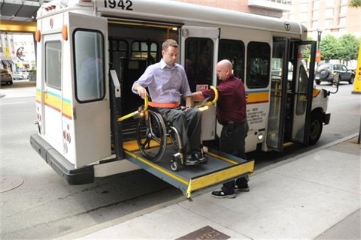
The Ride
THE RIDE paratransit service provides door-to door, shared-ride transportation to eligible people who cannot use fixed-route transit (bus, subway, trolley) all or some of the time because of a physical, cognitive or mental disability.
THE RIDE is operated by the Massachusetts Bay Transportation Authority (MBTA) in compliance with the federal Americans with Disabilities Act (ADA). Under the ADA, paratransit functions as a 'safety net' for people whose disabilities prevent them from using public transit.
Notes:
The Ride is an important aspect of disability when it comes to getting around in the Boston area. I knew someone who for a short period of her life was very heavily dependent on these services and they greatly aided not only her but her family and friends too. This is because they knew she had a safe way to get around when they couldn’t be the ones transporting her themselves. This peace of mind is often critical for loved ones.

Slide 19
The Carroll Center for the Blind: “Pathway to Independence”
“The Carroll Center serves the needs of blind and visually-impaired persons by providing rehabilitation, skills training, and educational opportunities to achieve independence, self-sufficiency, and self-fulfillment and by educating the public regarding the potential of persons who are blind and visually-impaired.”
Established in 1936
Services for the blind include vision rehabilitation services, vocational and transition programs, assistive technology training, educational support, and recreation opportunities for individuals who are visually impaired of all ages.
Notes:
Centers such as these are highly important in making impacts in the lives of others. The opportunities offered through this are immense and enable these individuals to flourish and thrive. It is also key that it takes a role in educating the public.

Slide 20
Massachusetts Office of Disability
“The Massachusetts Office on Disability (MOD) was created in 1981 under M.G.L. Chapter 6 Section 185. The primary mission of MOD is to ensure the full and equal participation of all people with disabilities in all aspects of life by working to advance legal rights, maximum opportunities, supportive services, accommodations and accessibility in a manner that fosters dignity and self determination. It is the state advocacy agency that serves people with disabilities of all ages.”
Notes:
Advocacy is a huge part of disability and having others joining forces to fight for the deserved rights for these people is immensely important. Without the push to get what is necessary there might not be as many opportunities or technologies we see for people today.

Slide 21
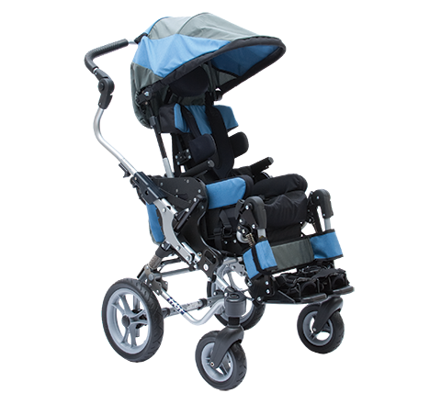
Quantum: “The Rehab Power Chair Solutions Company”
“In 2000, Quantum® Rehab was born out of the desire to serve those with complex rehab mobility needs with the most innovative, consumer-inspired power wheelchairs and related technologies possible.”
Notes:
I looked at this chair because of its unique mobility and wide range of selection on the types of chairs. The one pictured above is specified for a young child obviously but it is almost hard to tell it is not just a regular stroller! They have a wide range of mobility as well.

Slide 22
References
http://www.abilities.com/boston/list.html#m
http://colourswheelchair.com/about-us/
http://www.permobil.com/en/Corporate/Company/Company/This-is-Permobil/
http://www.invisibleproject.org/www/about-invisible-display/
http://offers.therealschoolofmusic.com/reach4real
https://www.youtube.com/watch?v=5G35nKyB340
http://www.tcapp.org
http://www.zotartz.com/Zot-Artz-mission.html
http://nepassage.org/about/
http://www.empowersci.org/about-us.html
http://www.uspainfoundation.org/about-us.html
http://mswheelchairmass.org/mission-statement.html
http://www.aloecream.biz
https://www.cambridgema.gov/~/media/Files/DHSP/Disabilities/abilitiesexpo/CCPD%20Rackcardsingle.pdf
http://www.theonlygarage.com/handicap-accessible-vehicle-repair.aspx
http://www.harbroauto.com/action.htm
http://www.mbta.com/riding_the_t/accessible_services/default.asp?id=17167
http://www.mbta.com/riding_the_t/accessible_services/default.asp?id=7108
http://carroll.org
http://www.mass.gov/anf/employment-equal-access-disability/oversight-agencies/mod/
http://www.quantumrehab.com/aboutus/company-overview.asp

